Slide 1

Evaluating & amending your zoning law
Lowville municipal building – September 29, 2020

Slide 2
Matt Johnson, Director of Planning at Tug Hill Commission
Alaina Mallette, Planner – filming and administering Zoom
THIS IS A NEW PRESENTATION – THANKS FOR BEING A PART OF IT!
Inspiration from Mark Gebo and NYS Department of State
QUESTIONS AFTER – if I can’t answer, will research and send an answer out to the group
TRAINING CERTIFICATES – will hand out / send to Zoom participants

Slide 3
PURPOSE OF ZONING
Protect public health, safety, and welfare
Regulate use, density, placement of structures on lots

Slide 4
Authorized in NYS statutes
(gearing presentation toward towns and villages)
Town Law – Article 16
Village Law – Article 7
Municipal Home Rule Law

Slide 5
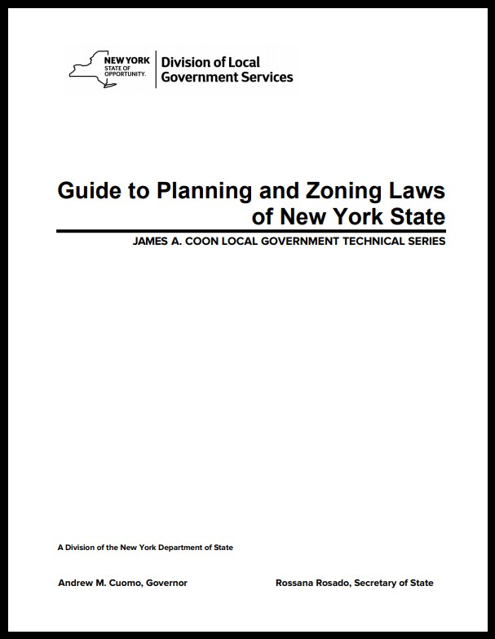
Great resource from NYSDOS…
www.dos.ny.gov/lg/publications.html

Slide 6
ZONING CANNOT…
regulate interior space
regulate ownership or be tied to ownership
control market or competition

Slide 7
ZONING SHOULD…
be in accordance with comprehensive plan
implement community vision and encourage orderly growth
protect important resources

Slide 8
ZONING SHOULD NOT…
create inequity
stifle creativity
be overly restrictive

Slide 9
A GOOD ZONING LAW SHOULD…
be clear, understandable, predictable and effective
be a living document – should be revised periodically

Slide 10
SYMPTOMS OF POOR PERFORMANCE
Increase in variance and interpretation requests
Increase in lawsuits
Out of sync with comp plan
Overabundance of nonconformities – ex. one acre minimum lot size in hamlets

Slide 11


Out of sync with statutes (is the law written on a typewriter?)
Unwieldy, unorganized – ‘Frankenstein law’ - sometimes you need to ‘hit reset’
ZEO can’t enforce the law

Slide 12
COMMON ISSUES
NOT ENOUGH ZONES or
TOO MANY ZONES – are distinctions trivial?
USES THAT ARE TOO GENERIC or
USES THAT ARE TOO SPECIFIED

Slide 13
NEW COURT DECISIONS AND LEGISLATION
Examples:
Signs – Reed v. Town of Gilbert
Manufactured homes – NYS Exec. Law Section 616

Slide 14

NEW USES
Large scale solar
Tiny houses
RVs
Short term rentals
Accessory structures
Covid-19 - OUTDOOR DINING?
photo: Lewis County Planning

Slide 15
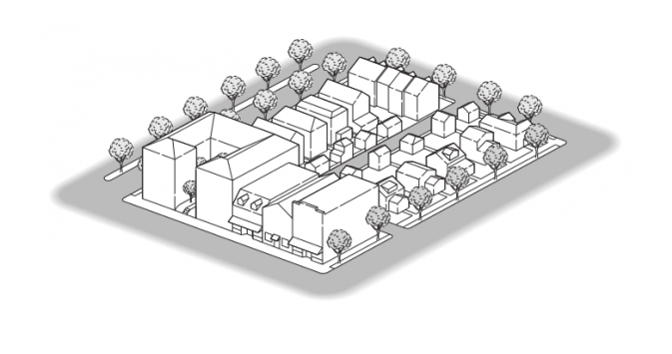
NEW IDEAS IN PLANNING
Form based zoning – focus on dimensional, bulk, architectural standards rather than USE
Looser parking standards – less emphasis on minimum number of spaces, especially in downtown areas

Slide 16
WHAT MAKES A GOOD LAW?
Purpose statement
Statutory authority section
Separability clause
Well crafted definitions – do not regulate in definitions

Slide 17
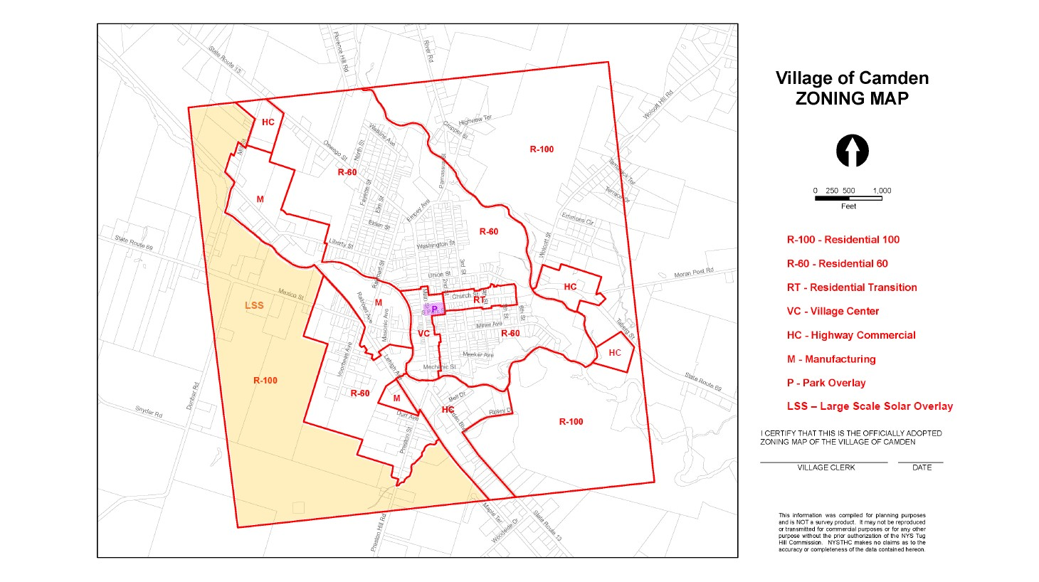
Reference to zoning map
Statement that any use not listed as permitted is prohibited
Good measurement methodologies – setbacks, yards, lot width, lot depth
Zoning permit required

Slide 18
Certificate of compliance
Zoning map with clear, definable boundaries
Well crafted nonconformity provisions
Logical process for applicant

Slide 19
Don’t include things that aren’t zoning – messy conditions, lawn maintenance, unsafe buildings
Not overly complicated –give ‘em a break vs. complexity
Avoid redundancy – avoid bulkiness/excess length
Codify into ONE document – NYSDOS local law search
Make sure all cross-references are correct!

Slide 20
DON’T DO THIS ON YOUR OWN!!!
Get help from Tug Hill Commission, your county planning department, or a consultant!
Involve ZEO, PB, ZBA, TB/VB
and municipal attorney!

Slide 21
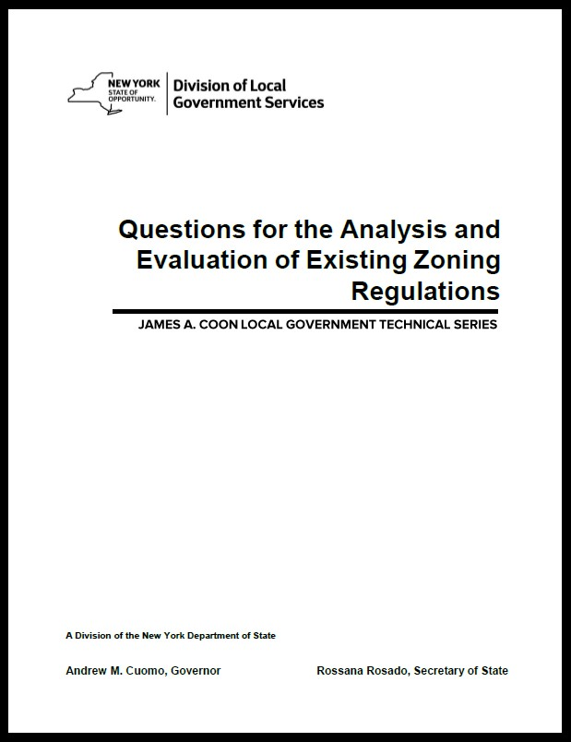
Great resource from NYSDOS…
www.dos.ny.gov/lg/publications.html

Slide 22
We recommend adoption by Local Law
Power to enact local laws is granted by the State Constitution (not a strictly delegated power from the State Legislature)
A local law has the same status as an act of the State Legislature

Slide 23
Procedure is typical local law adoption PLUS requirements specified in planning statutes and SEQR

Slide 24
1. amendment is introduced by a town board member at a town board meeting
copy is filed in the town clerk’s office
2. SEQR – lead agency completes full EAF and makes SEQR determination
3. amendment is sent to County Planning Board for 239-m review
4. town board passes resolution setting date for public hearing
5. notice of hearing in newspaper at least ten days prior to hearing
notice of hearing to clerks of neighboring towns and villages, SPs, HAs
notice of hearing to clerk of the County Legislature at least ten days prior to hearing
amendment is placed on desk of each town board member at least seven days not including Sunday prior to hearing
6. public hearing is held
7. town board adopts amendment
8. town board reports action to County Planning Board
9. town clerk files the amended law and map with the Secretary of State within 20 days of adoption – local law form completed
10. copy of law is entered in the minutes of the town board and filed with the town clerk
11. summary of the law is published in the newspaper and posted at the main entrance of the town clerk’s office

Slide 25
Town of Lowville Example
1. Amendment is introduced by a town board member at a town board meeting - copy is filed in the town clerk’s office

Slide 26
SEQR – lead agency completes full EAF and makes SEQR determination
Likely a Type I action… Town is lead agency

Slide 27
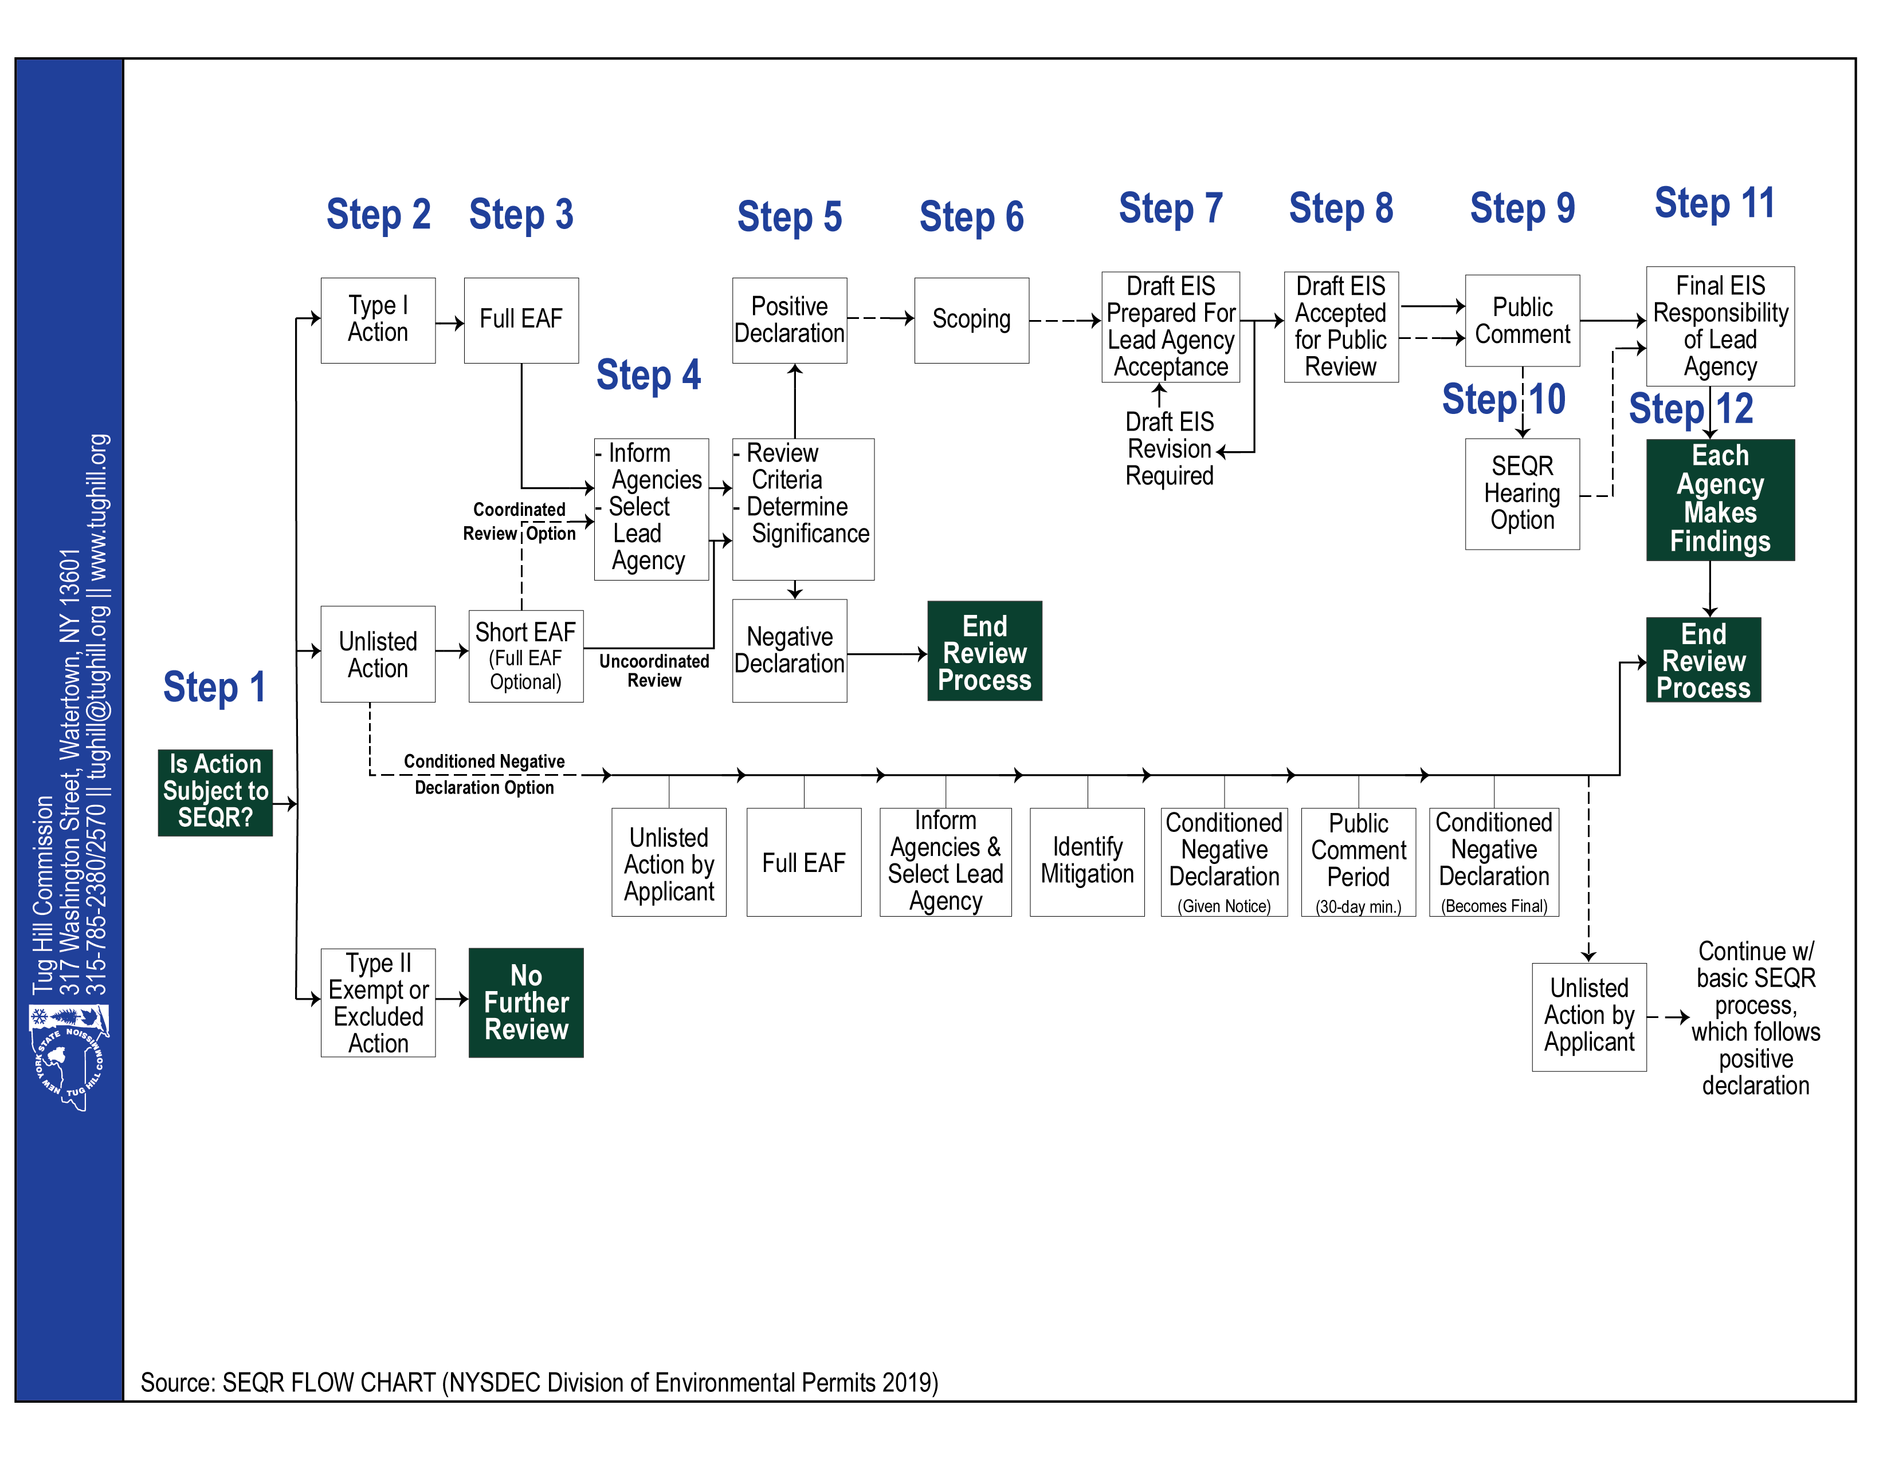

Slide 28
Amendment is sent to Lewis County Planning Board for 239-m review
Package includes Part I of the EAF
CPB has 30 days to review (or up until two days prior to TB final adoption)

Slide 29
Town board passes resolution setting date for public hearing
notice of hearing in newspaper at least ten days prior to hearing
notice of hearing to clerks of munis within 500 feet – towns of Denmark, Harrisburg, Martinsburg, New Bremen, Watson and the Village of Lowville at least ten days prior to hearing
notice of hearing to clerk of the Lewis County Legislature at least ten days prior to hearing
Also notice to state parks and housing authorities

Slide 30
Public hearing is held
Minutes of hearing must contain at least general details about what each speaker said

Slide 31
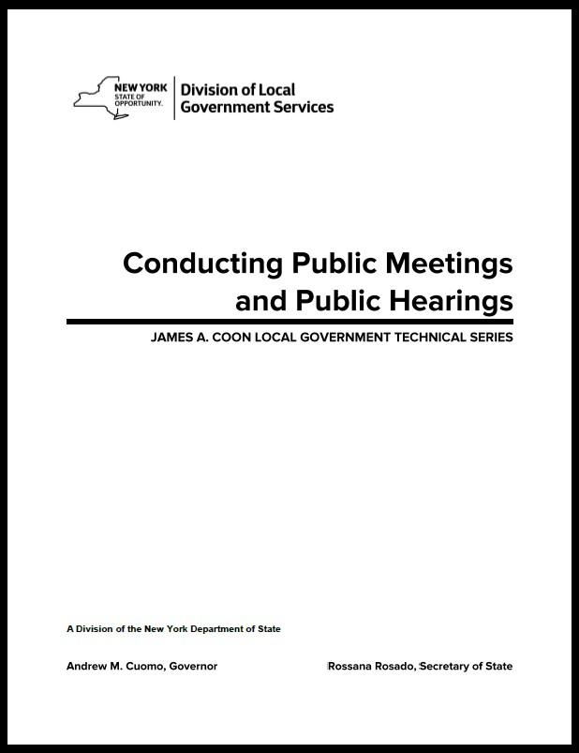
Great resource from NYSDOS…
www.dos.ny.gov/lg/publications.html

Slide 32
Town board adopts amendment
Law must have been on the desks of TB members at least seven calendar days, exclusive of Sunday OR mailed at least ten calendar days, exclusive of Sunday
Supermajority needed if acting contrary to County recommendations

Slide 33
3/4th vote needed if written protest signed by…
(a) the owners of twenty percent or more of the area of land included in such proposed change; or
(b) the owners of twenty percent or more of the area of land immediately adjacent to that land included in such proposed change, extending one hundred feet therefrom; or
(c) the owners of twenty percent or more of the area of land directly opposite thereto, extending one hundred feet from the street frontage of such opposite land.

Slide 34
Town board reports action to Lewis County Planning Board within 30 days of final action
set forth reasons if acting contrary

Slide 35
9. Town clerk files the amended law and map with the Secretary of State within 20 days of adoption – local law form furnished by NYSDOS
No deletions, strikethroughs, underlines, italics denoting changes
Law becomes effective after filing with Secretary of State

Slide 36
10. Copy of law is entered in the minutes of the town board and filed with the town clerk

Slide 37
11. Summary of the law is published in the newspaper and posted at the main entrance of the town clerk’s office

Slide 38
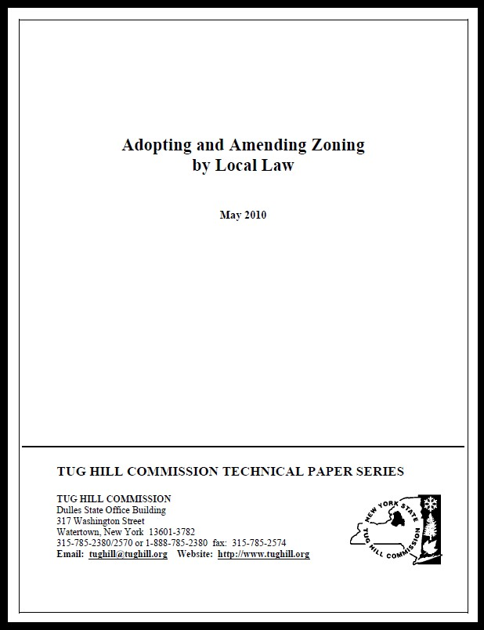
For more detail…
tughill.org/publications/technical-issue-papers/

Slide 39
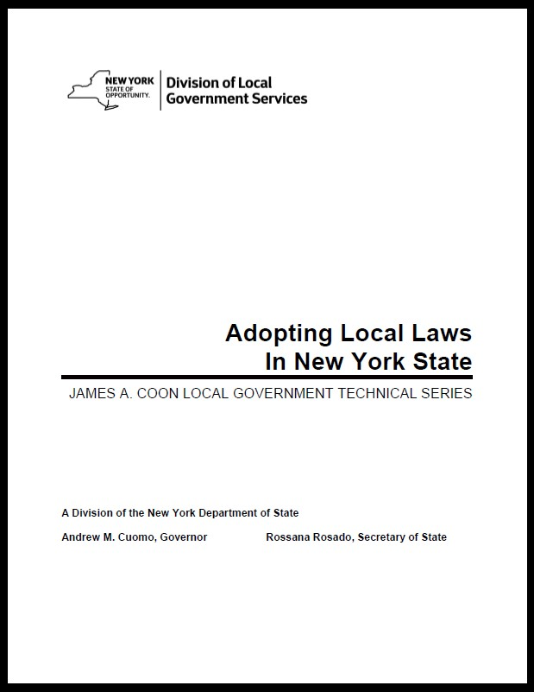
If you want to ‘geek out’…
www.dos.ny.gov/lg/publications.html

Slide 40
THANKS AGAIN!!
matt@tughill.org
(315) 785-2380
www.tughill.org

