Slide 1


DECALS Information & Reminders Kevin Maloney/License Sales Supervisor
NYS DEC

Slide 2
Introduction
Kevin Maloney – NYS DEC Fish & Wildlife – License Sales Supervisor
I have worked for Fish & Wildlife as the License Sales Supervisor for about 10 years. My office handles a lot of calls and questions from License Issuing Agents, oversees agent training and addresses customer and general public questions as they relate to sporting licenses.
The topics I will be covering today are items that License Issuing Agents ask us about all the time. Hopefully by reviewing them today it will help you not only understand these topics more but also make you aware of the processes and tools that are in place to help make working with DECALS a little easier for you all.

Slide 3
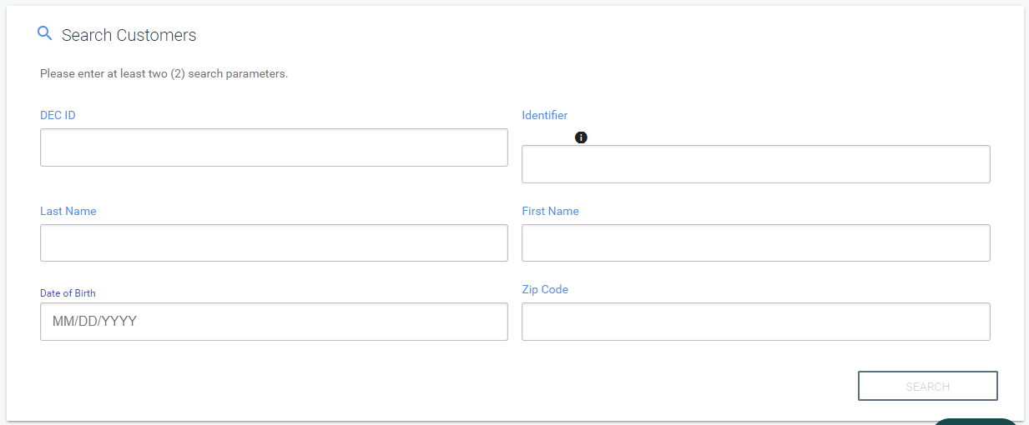
Customer Searches
You only need to use 2 of the search parameters
You can perform searches in various ways using only 2 search parameters such as:
Last name and date-of-birth
DEC ID# and last name
Driver’s license # and last name
Driver’s license # and date-of-birth
L

Slide 4
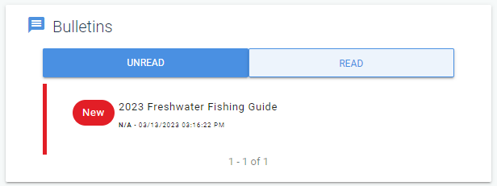
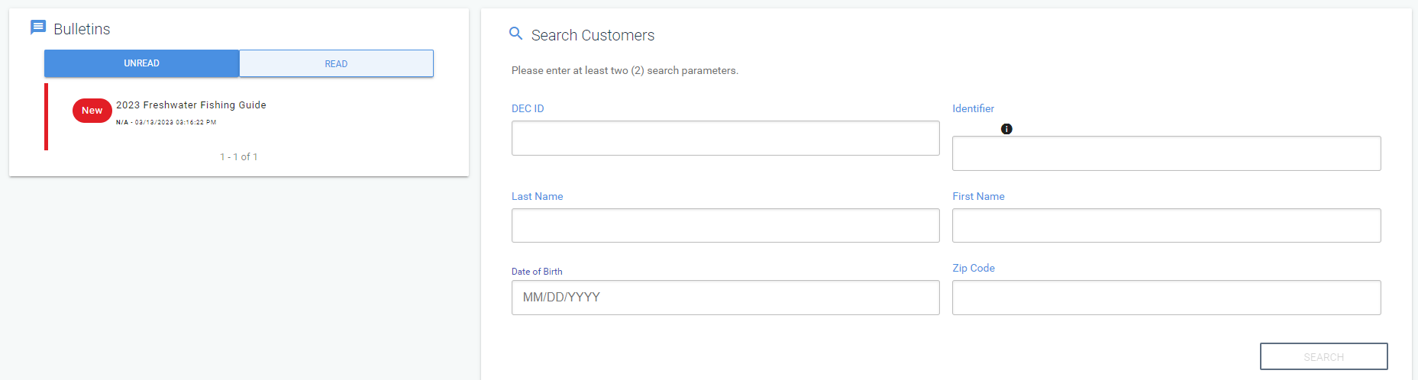
DECALS Bulletins/Messages
Be sure to read your bulletins
Bulletins are found on the customer search page
Each DECALS user has access to their own messages
Once bulletins are read, they move from “Unread” to “Read”
Since each user has their own bulletins, they stay “Unread” until they read them instead of one person reading them

Slide 5

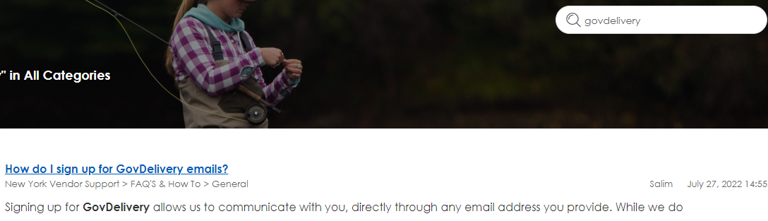
GovDelivery Messages/Emails
Please sign up for GovDelivery messages/email
GovDelivery allows us to communicate with DECALS users through an email address they provide, even if the system goes down
You can sign up for GovDelivery through the Agent Help Center.
Click on the “Help” widget in the lower right corner of DECALS:
Once in the Agent Help Center, type “GovDelivery” in the search and press enter.
Click on the “How do I sign up for GovDelivery emails” result and follow the instructions from there.

Slide 6
DECALS Usernames & Passwords
Everyone using DECALS should have their own username & password
This will help keep track of the actions taken in DECALS
Each user gets their own messages therefore leaving them marked as unread until viewed
The Agent of Record (AOR) for each location creates additional users
Sharing the AOR’s sign in credentials allows other users to work in DECALS as the administrator and appears that actions taken are done by the person DEC has on record as the AOR.

Slide 7
Agent of Record (AOR) Changes
If the AOR or Town Clerk changes, DEC needs to know
Failure to notify DEC about a change in AOR could mean you will not have access to DECALS until all requirements are completed
If the AOR or Town Clerk changes, a new Agent Agreement will need to be completed and sent to NYS DEC Revenue Accounting
In most cases, the new AOR will need to take DEC’s formal training and then pass a quiz
To notify DEC of such a change please email Supervisor.License@dec.ny.gov. Let us know who you are and what town you are from and we will get you what you need to move forward with the change

Slide 8
Hunting & Trapping Guides/Freshwater Fishing Guides
Initial shipments of each guide are automatically sent to active agent locations based on sales from the previous year. No need to contact us and order the new guides
New freshwater fishing guides come out every April and new hunting/trapping guides come out every August
If you need to order more guides, after the initial shipment, send an email to huntfishguideorders@dec.ny.gov. Be sure to include the following information:
Location Name
DEC Agent ID#
Physical/Shipping address (No PO Boxes)
Type of guide you need and the quantity you need
Phone #

Slide 9
Questions? Comments? License Sales Office, Agents Only, not for the public: 1-800-622-0280 (M-F, 8am-4pm) Email: Supervisor.License@dec.ny.gov

