Slide 1
Lo the angler.
He rises in the morning and upsets the whole household.
Mighty are his preparations.
He goes forth with great hope in his heart –
and when the day is far spent he returns,
smelling of exertion and strong spirits.
And the truth is not in him.

Slide 2
In 1918 The Camden Queen Central News reported that
Grace Peck and William Harrison Mills - married
Eva Stowell and Ray Stevenson - engaged
A violent electrical storm
damaged a Church in McConnellsville
three area barns destroyed by lightning
burned hay, killed foul and swine
AND

Slide 3
In 1918 The Camden Queen Central News reported that
Grace Peck and William Harrison Mills - married
Eva Stowell and Ray Stevenson - engaged
A violent electrical storm
damaged a Church in McConnellsville
three area barns destroyed by lightning
burned hay, killed foul and swine
Anglers were catching three-to-six- pound brook trout from the Salmon River at Redfield.

Slide 4
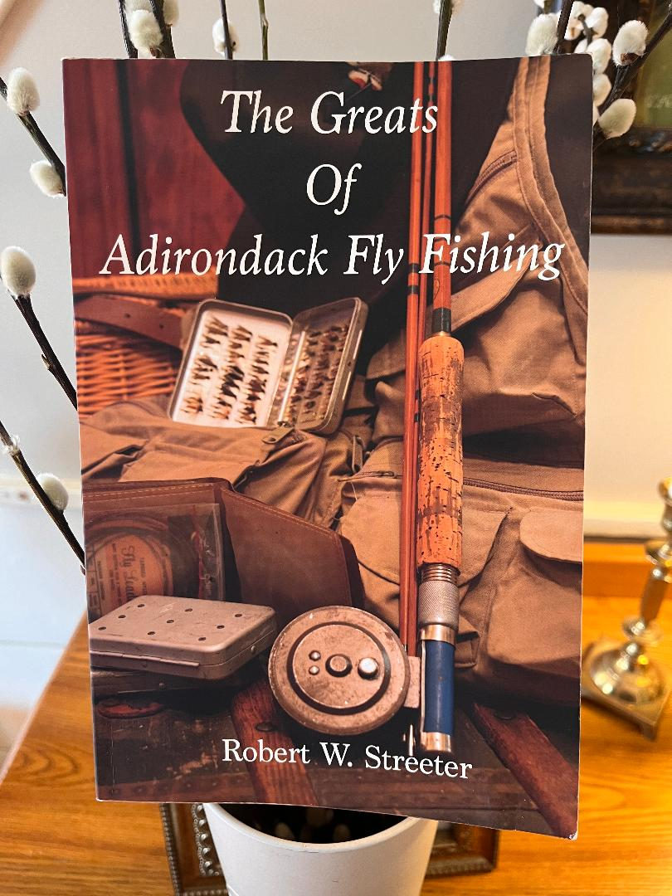
William E Scripture, Jr.
Fly fisherman – Favored streamers
Fished all over but loved the East Branch of Fish Creek - Taberg to Fish Creek Club
3 to 5 pound fish - both brookies and browns.

Slide 5
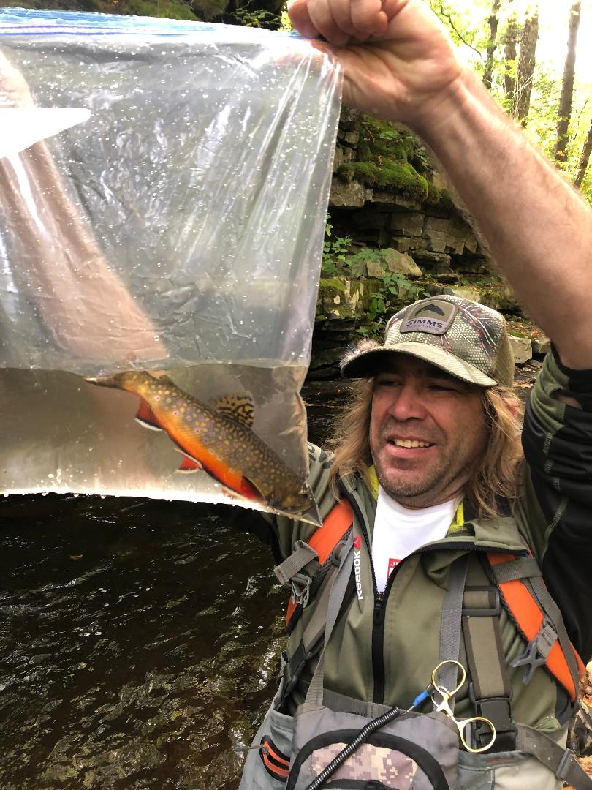
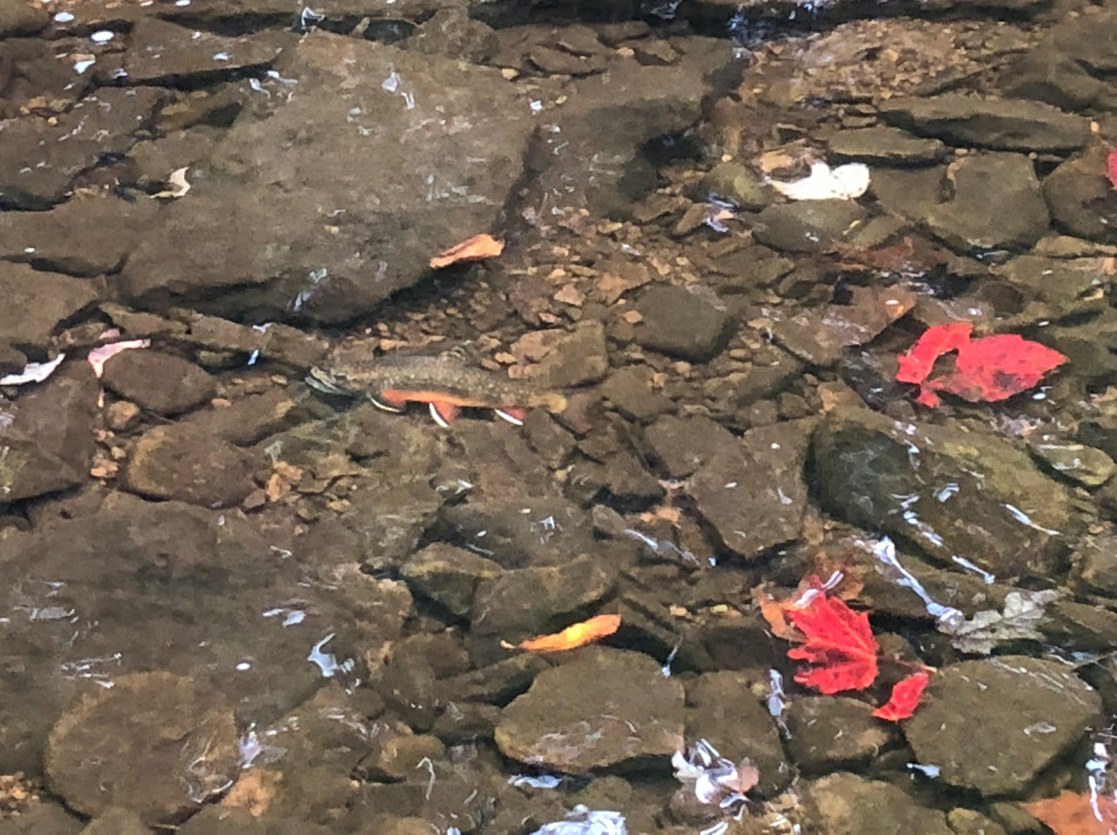

Slide 6
Habitat Degradation Happened
Dams and obstacles to fish movement
Isolation from food, mates and spawning habitat
Deforestation
Warming water
Bank erosion
Sedimentation
Exotic/invasive species
Pollution
Acid rain/deposition
CLIMATE CHANGE

Slide 7

Trout Unlimited – a national conservation organization
Mission: To bring together diverse interests to care for and recover rivers and streams so that our children can experience the joy of wild and native trout and salmon.
Vision: For communities across America to engage in the work of repairing and renewing our rivers, streams, and other water bodies on which we all depend.

Slide 8
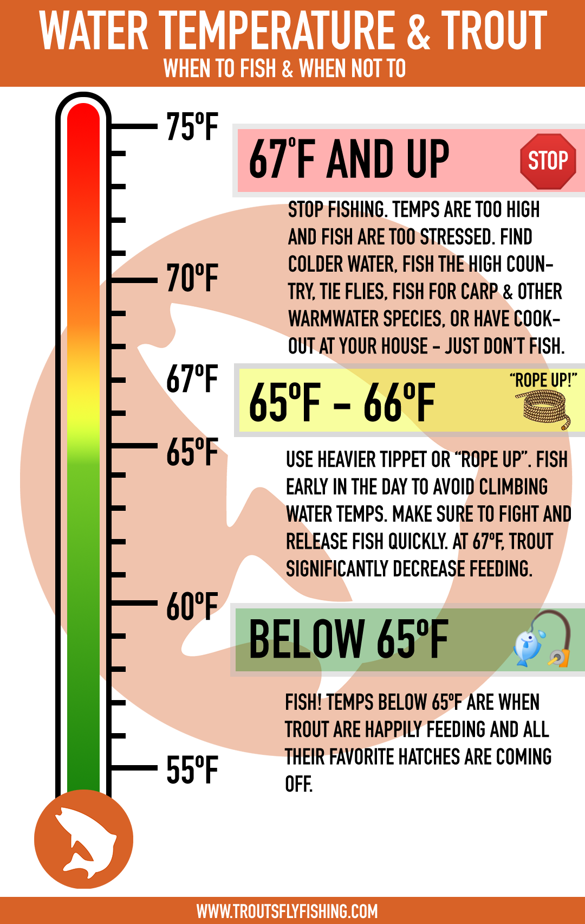

Slide 9
Protect - wild trout and salmon and their habitat
Reconnect - waterways so they can function naturally
Restore - populations of native fish
Sustain - those fisheries thru advocacy and education

Slide 10
Terminology - Just to confuse you
Native – Species naturally occurring here
Wild - Individual born here but not necessarily from here
Exotic - Species not from around here
Invasive – Species not from around here and harmful to the new environment

Slide 11
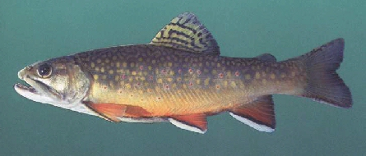
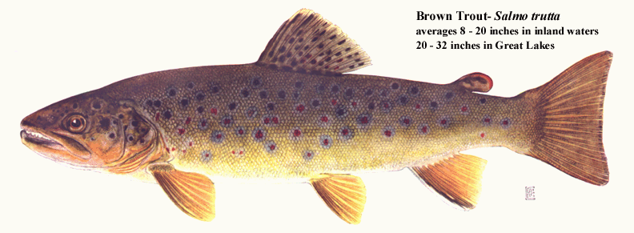
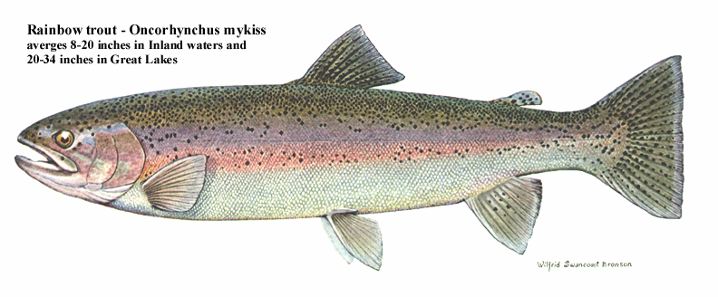
Brook Trout Native
Brown Trout Exotic
Rainbow Trout
Exotic

Slide 12
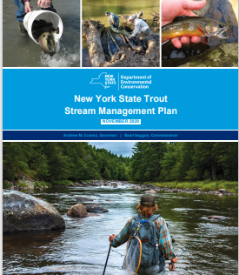
Guiding Principles for Trout Stream Management
Wild Trout
Habitat
Stocked Trout
Angling Opportunity
Management Approach

Slide 13
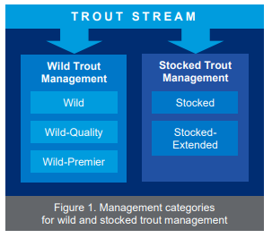

Slide 14
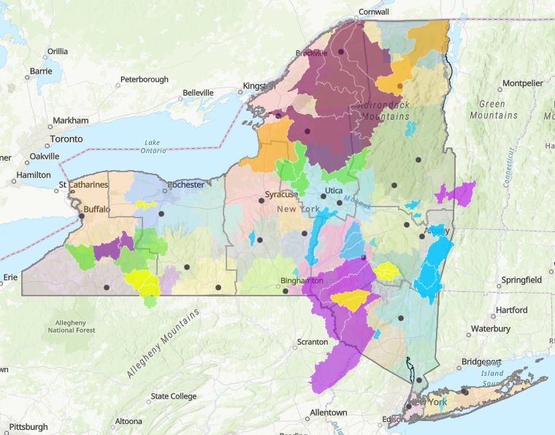
Finding the Right Places – TU’s Priority Waters
Strongholds, those large, intact habitats that support healthy populations.
Climate resilient populations that occur in habitats anticipated to persist in the face of changing climate.
Populations that represent the range of ecological, life history, and genetic diversity across a species’ distribution.
Outstanding wild trout waters where there is no conflict with native species management objectives.

Slide 15
UPDATE -- What We Want to Accomplish
Promote a singular NY Priority Waters concept for use at all NY TU organizational levels
5-year forward view
5-10 high quality projects
Portfolio perspective
Continuous refinement of the NY Priority Waters Maps
Follow the data
identify specific Priority Waters for protection, restoration, reconnection, and reintroduction
Use the NYS DEC Trout Stream Management Plan Categories
As a simple project development concept for chapters
As a shared tool for collaboration with NYS DEC
Identify and strengthen partnerships across all levels of TU through improved communication
Council
Regional
Chapter

Slide 16
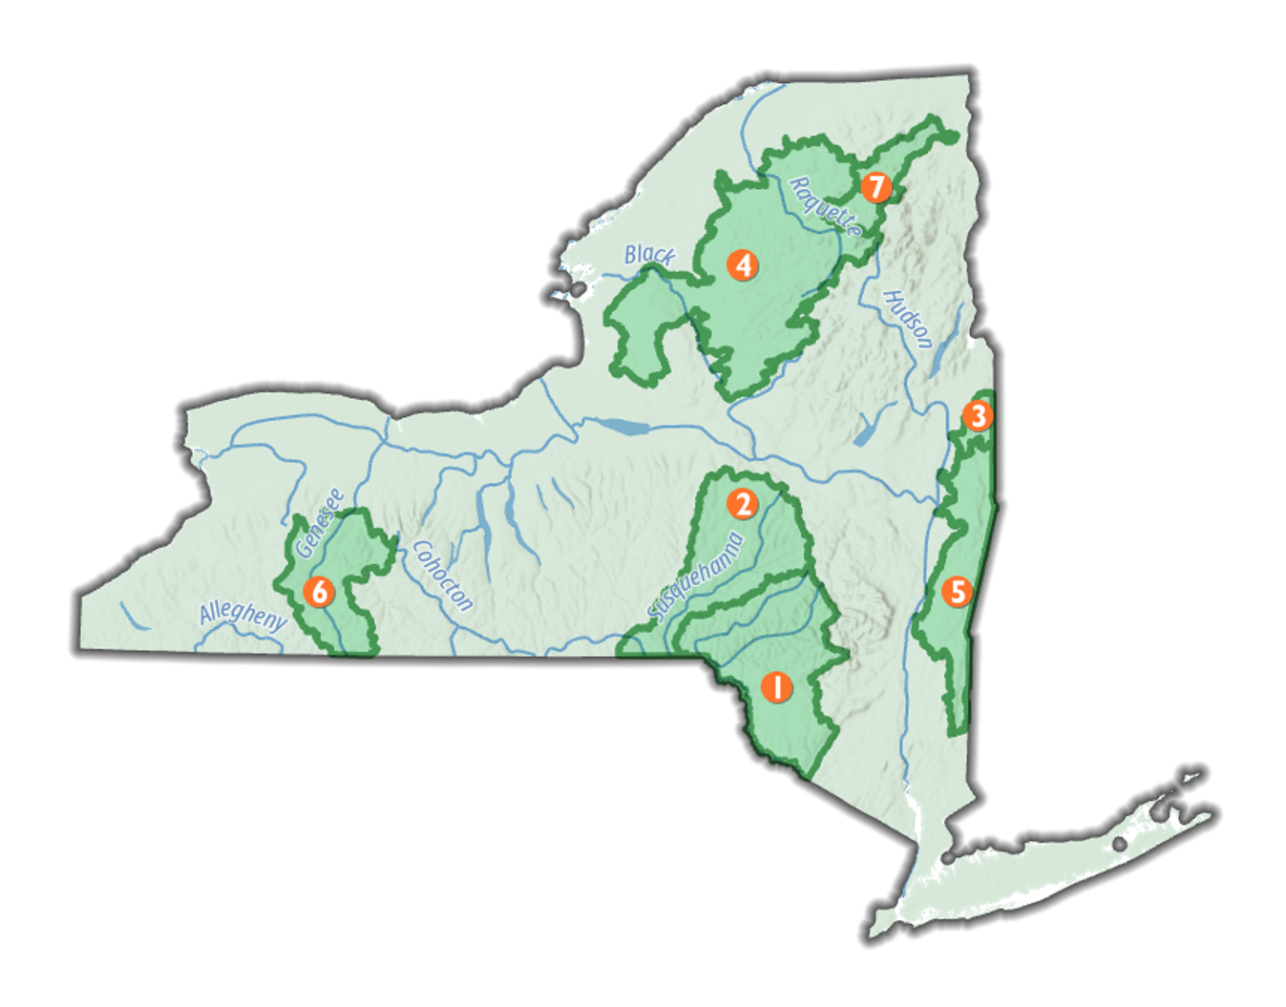
NewYork
Priority Waters

Slide 17
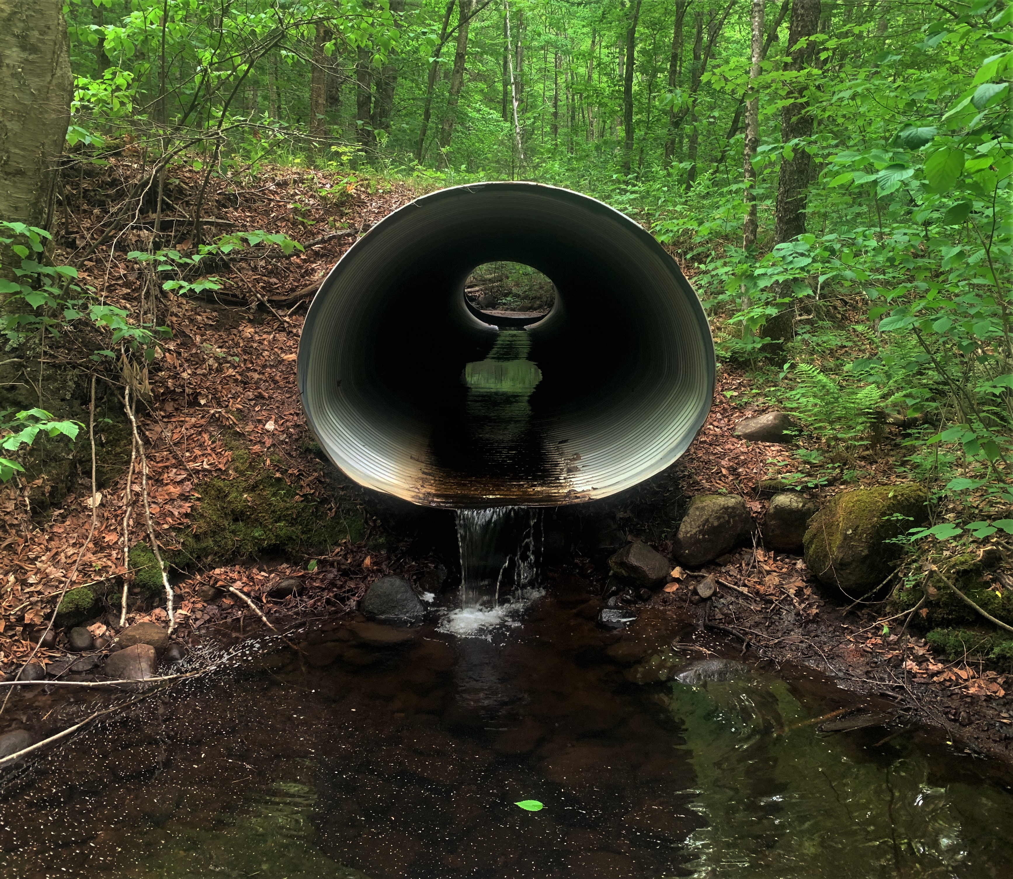
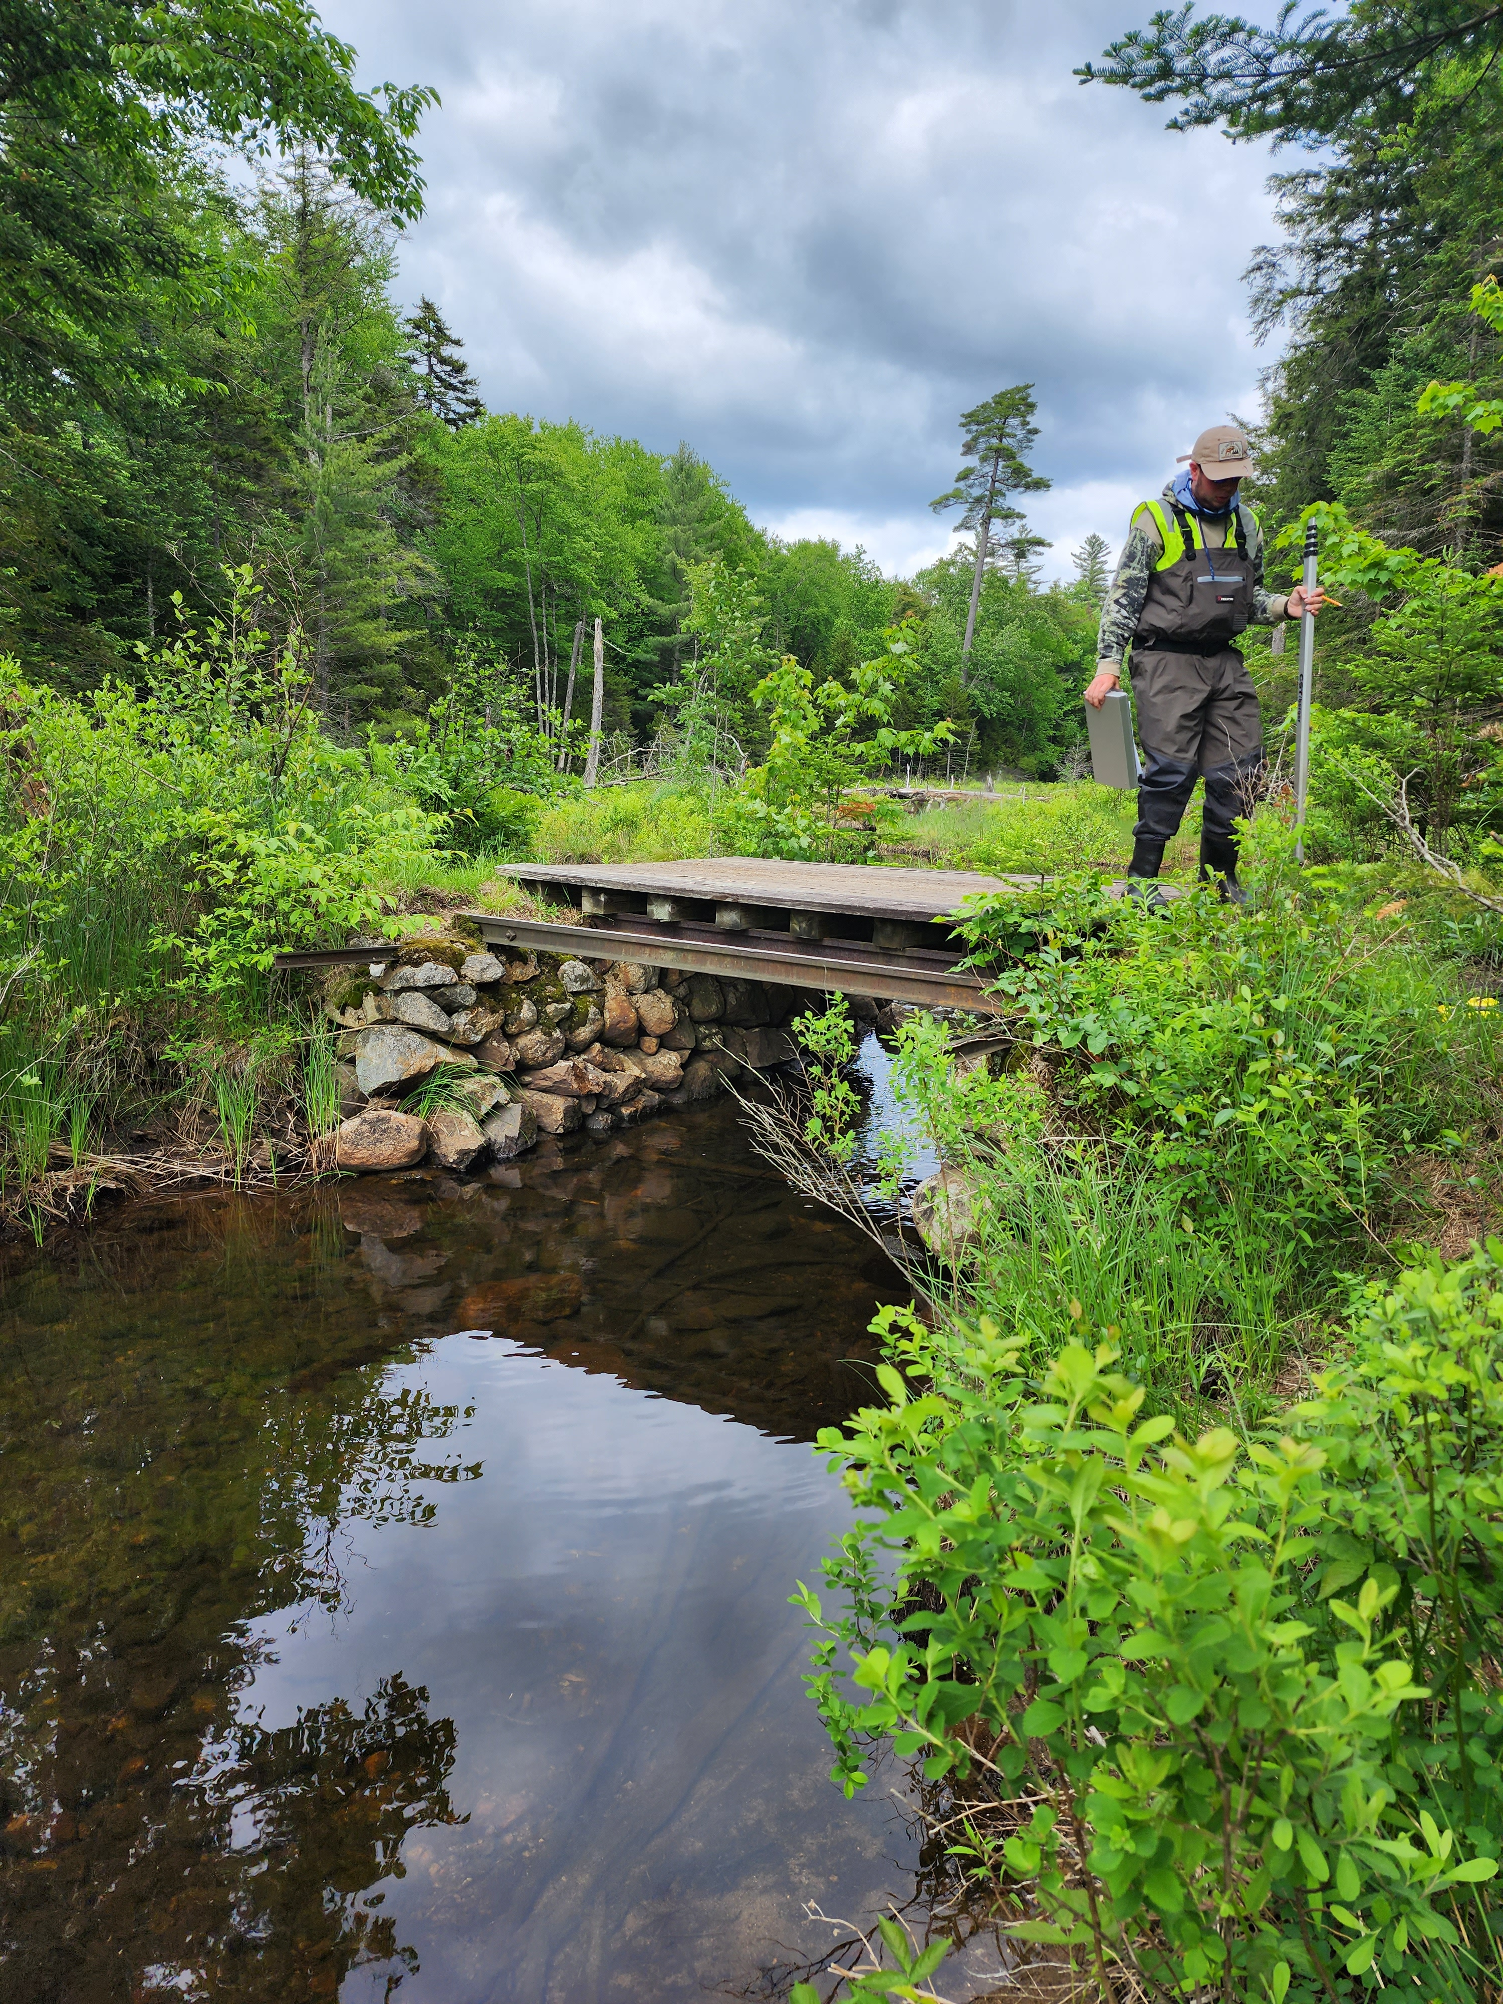

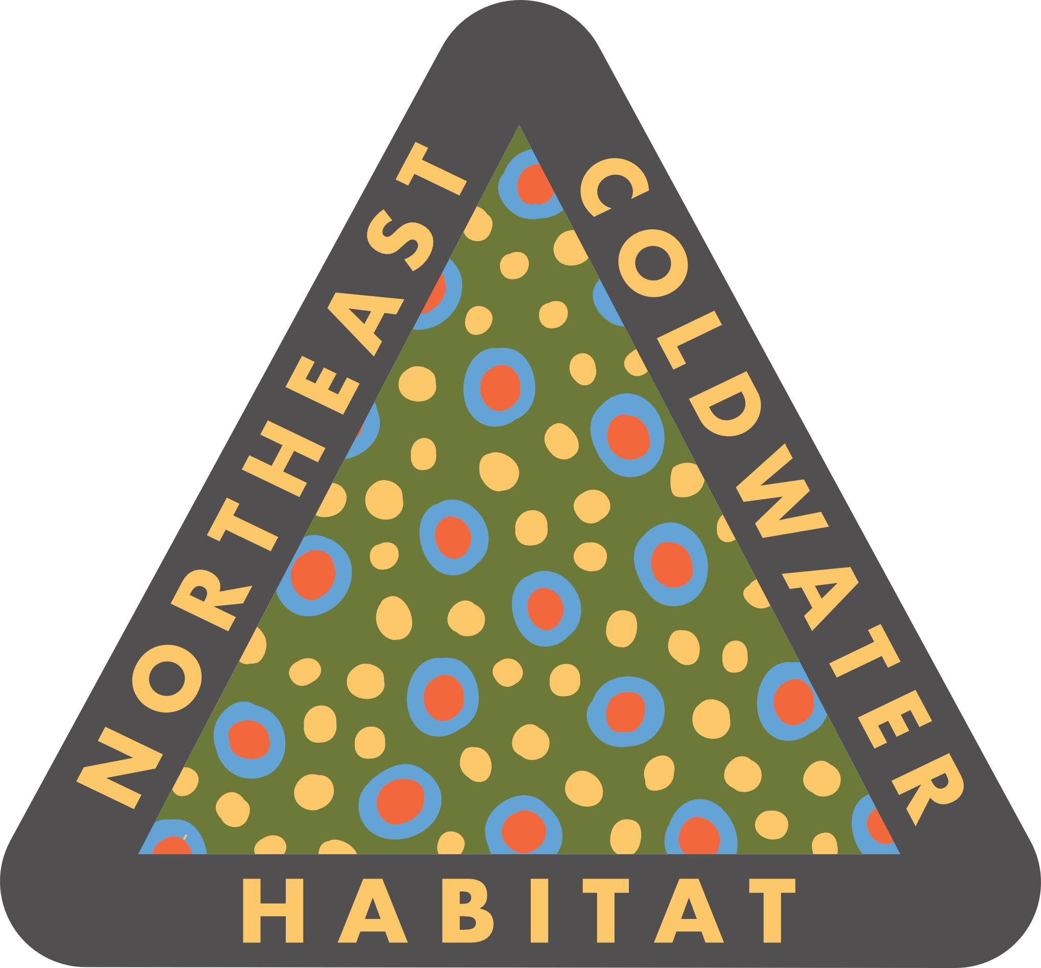
RECONNECT !
Tug Hill Region – Trout Unlimited
Aquatic Passage Project Outline

Slide 18
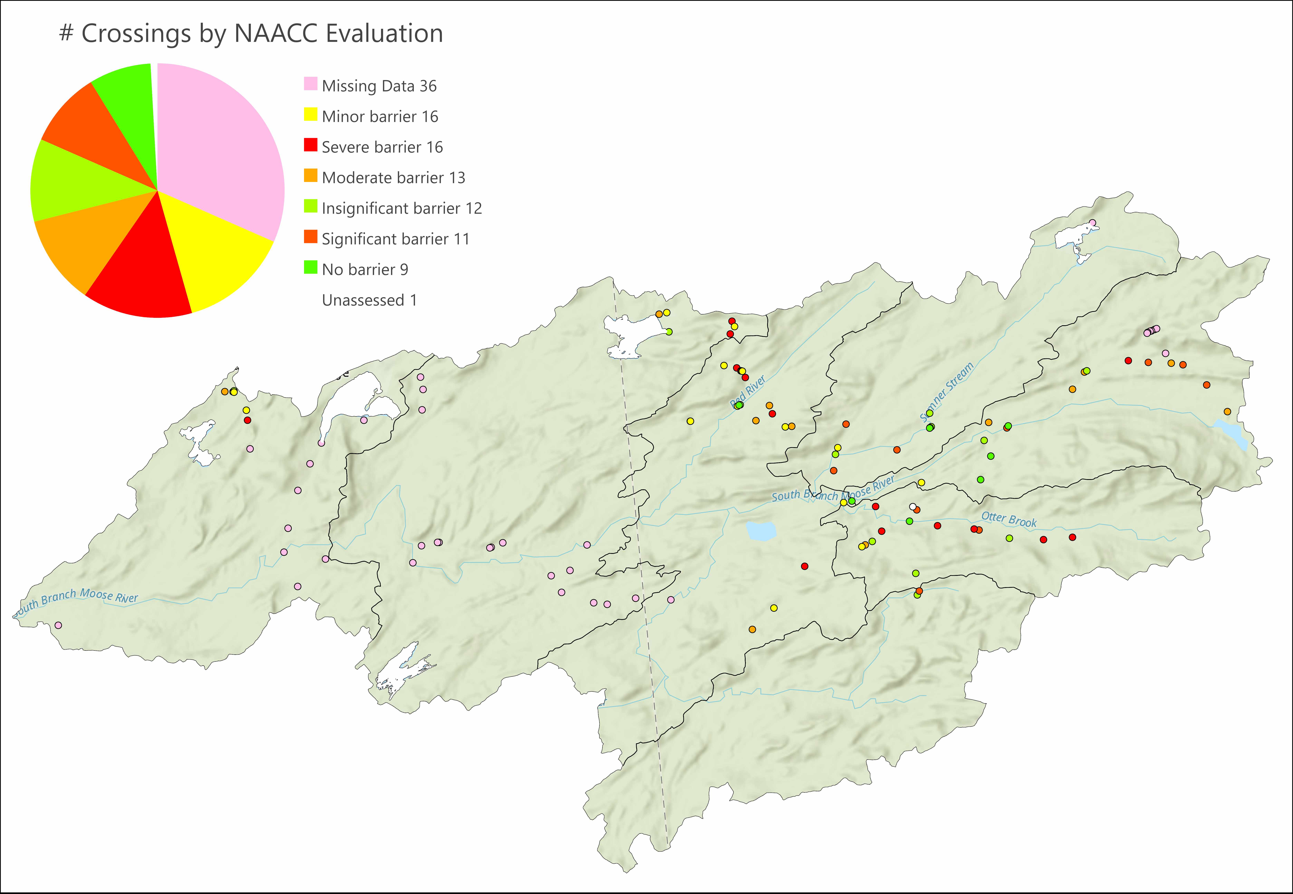
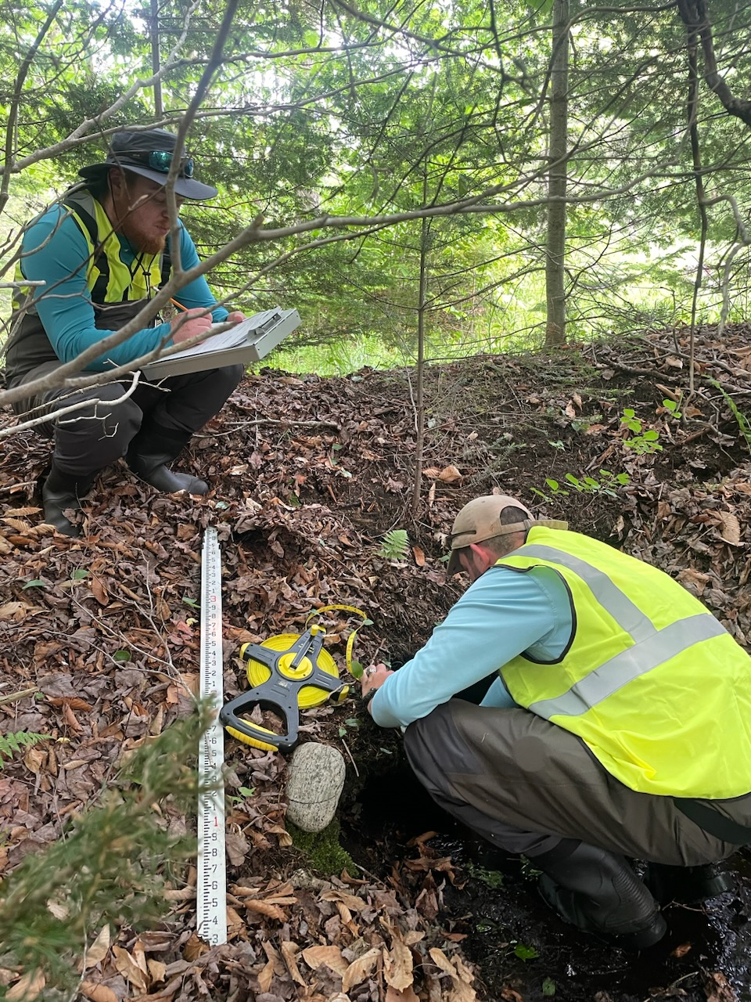
America’s first state forest reserve still harbors native Eastern brook trout and still draws anglers. In this national landmark, we are assessing watershed fragmentation on the west slope streams, which drain into Lake Ontario, we anticipate surveying hundreds of culverts on state land. In the Black River watershed, we are reconnecting tributaries by replacing failing or undersized culverts.

Slide 19

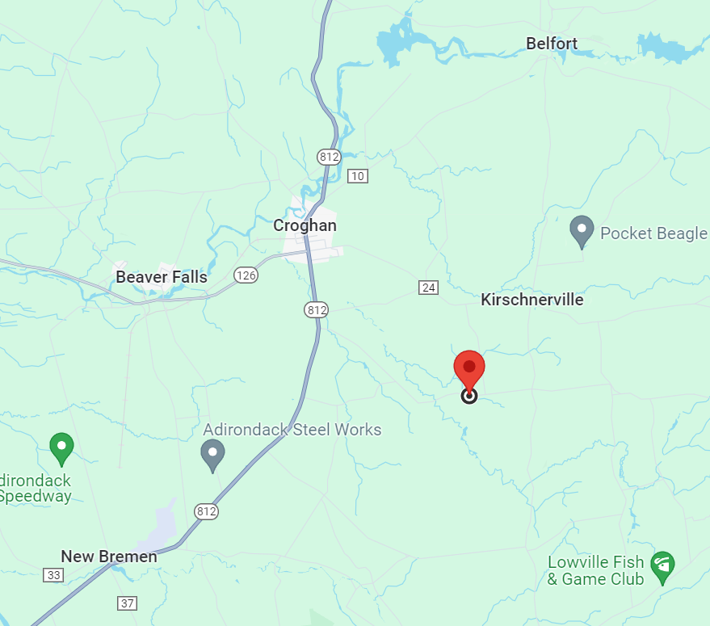
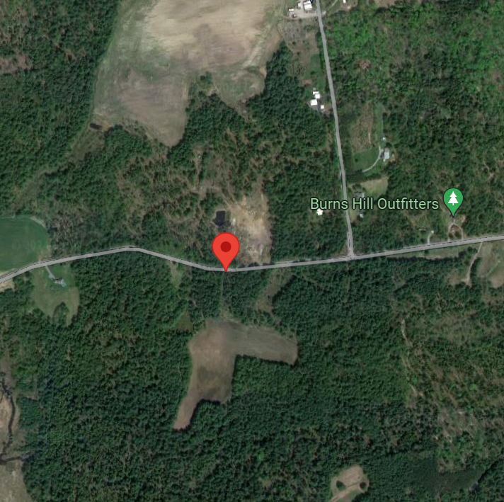
Trout Unlimited Brewery Rd Culvert Replacement Project
Town of New Bremen, NY
Address: East of 7236 Brewery Rd, New Bremen, NY 13367
Location Description: 1200 feet west of the intersection of Brewery Rd and Briot Rd
HUC12: 041403011105
Latitude/Longitude: 43.866000, -75.352210

Slide 20
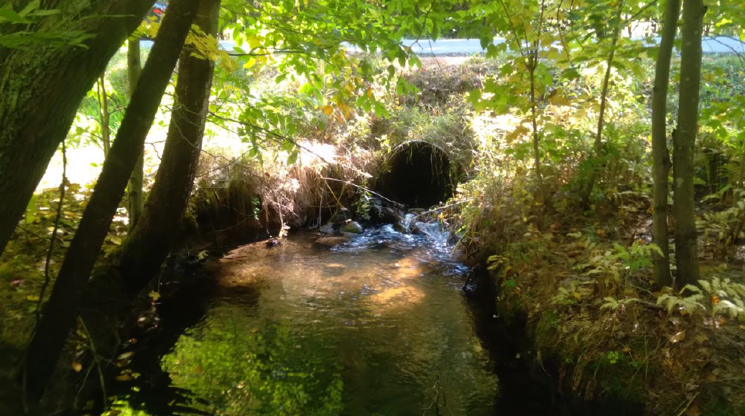
Trout Unlimited Brewery Rd Culvert Replacement Project – Town of New Bremen, NY
Project Goals:
Remove significant barrier for aquatic organisms and reduce habitat fragmentation for brook trout.
Reconnect 2.6 miles upstream (USGS NHD) and 0.36 miles downstream to confluence with Black Creek.
Improve stream conditions by creating a stable stream reach that is climate change resilient.
Improve town infrastructure to reduce maintenance costs and ensure flood resiliency
Minimize project construction footprint and maintain mature vegetation.
Ownership:
Town of New Bremen, majority of the work with be done within the town’s right-of-way. The town highway department will contribute to site restoration. The project will be completed by a hired contractor.
Partners:
USFWS Partners for Wildlife – lead agency Nationwide Permit-27 review
Lewis County Soil and Water Conservation District - monitoring
Funding:
WQIP Round 18 (C01898GG)
Project Timeline:
Implementation summer 2024
Class C(T) un-named tributary to Black Creek, tributary to the Beaver River. The culvert is a significant barrier for aquatic organism passage based on NAACC Survey ID 85334 evaluation.

Slide 21
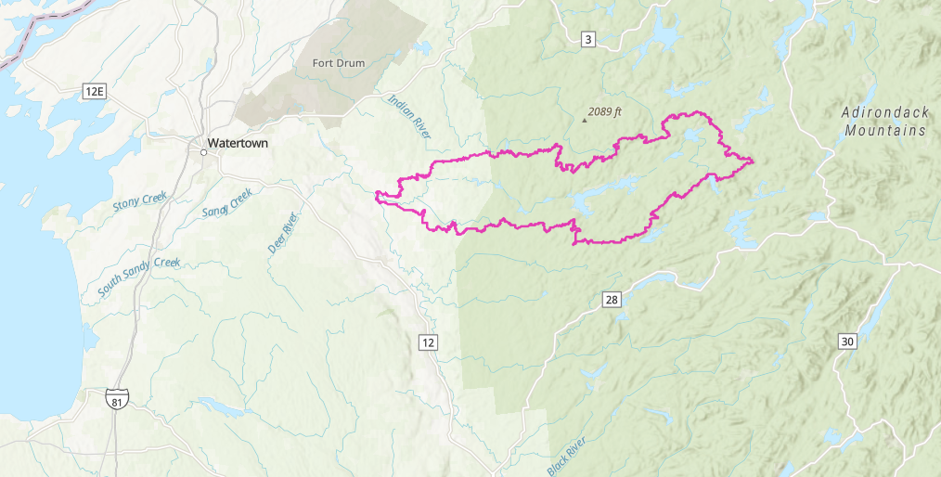
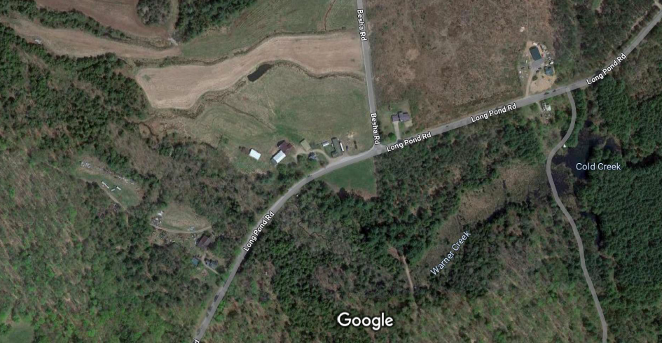
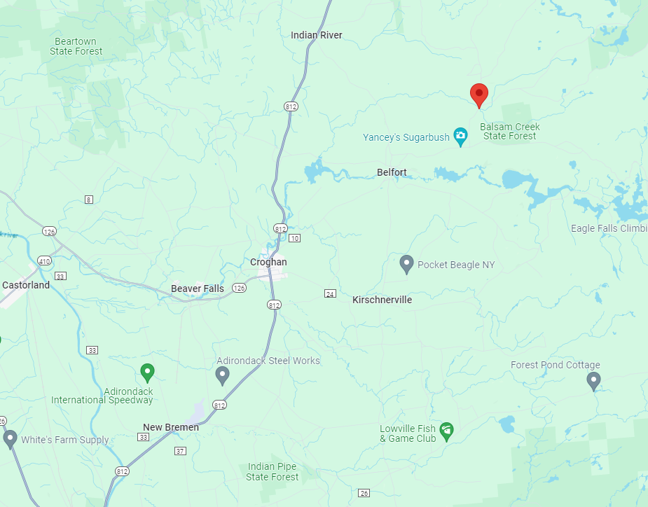

TU Long Pond Road Over Warner Creek Culvert Replacement Project
Town of Croghan NY
Permit Designs Version 1
April 10, 2024
Warner Creek Crossing
85040, 3' cm
Balsam Creek Crossing
7' BP
Address: Near 8235 Long Pond Rd., Croghan, NY 13327
Location Description: The Warner Creek crossing is located on Long Pond Road feet ~500’ south/southwest of the intersection of Long Pond Road and Bisha (or Kilbourn) Road in the Town of Croghan in Lewis County (Figure 1).
HUC12: 041403011103
Latitude/Longitude: 43.95102, -75.28877

Slide 22
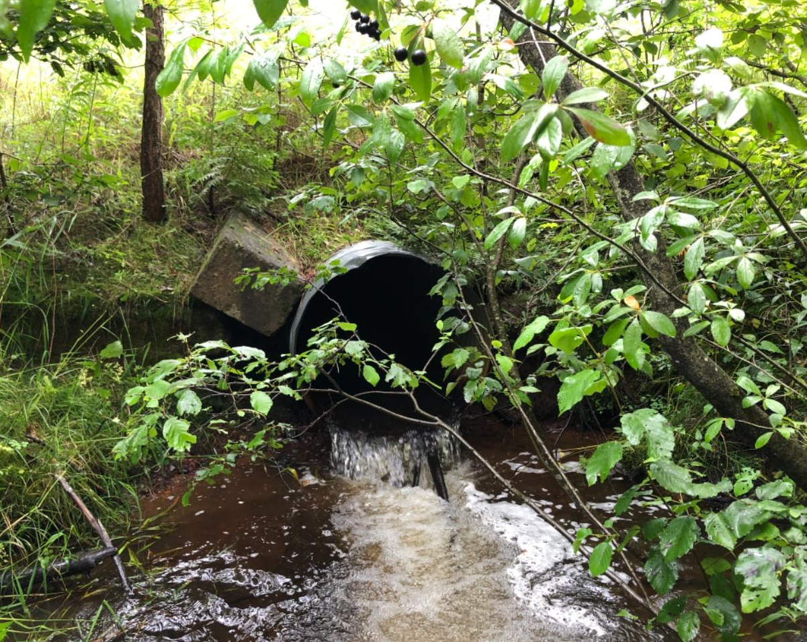
TU Long Pond Road Over Warner Creek Culvert Replacement – Town of Croghan, NY
Project Goals:
Remove significant barrier for aquatic organisms and reduce habitat fragmentation for brook trout.
Reconnect aquatic organism passage for 4.9 miles upstream (USGS NHD Flowlines) and 5.8 miles downstream to the next confluence with Beaver River. There are no barriers downstream.
Improve stream conditions by creating a stable stream reach that is climate change resilient.
Improve town infrastructure to reduce maintenance costs and ensure flood resiliency
Minimize project construction footprint, maintain mature vegetation and expand riparian restoration upstream and downstream of the site.
Ownership:
Town of Croghan, majority of the work with be done within the town’s right-of-way; town securing easements from landowners for additional instream work. The town highway department will complete project construction.
Partners:
USFWS Partners for Wildlife – lead agency Nationwide Permit-27 review
NYS DEC Region 6 – Fish monitoring
Funding:
WQIP Round 18 (C01898GG) Project Timeline: Summer 2024
Warner Creek is a Class C(T) tributary to Balsam Creek in the Beaver River Watershed. The culvert is a significant barrier for aquatic organisms (NAACC Survey ID 85040). Beaver River flows to the Black River, a tributary to Lake Ontario.

Slide 23
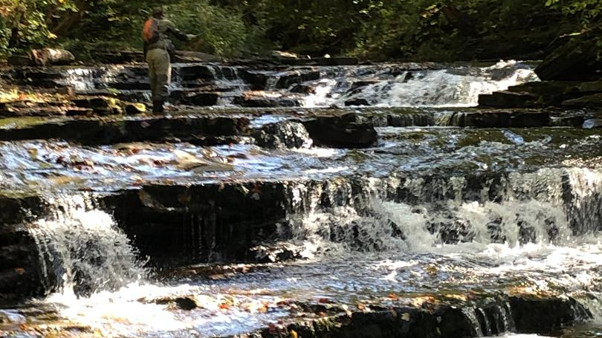

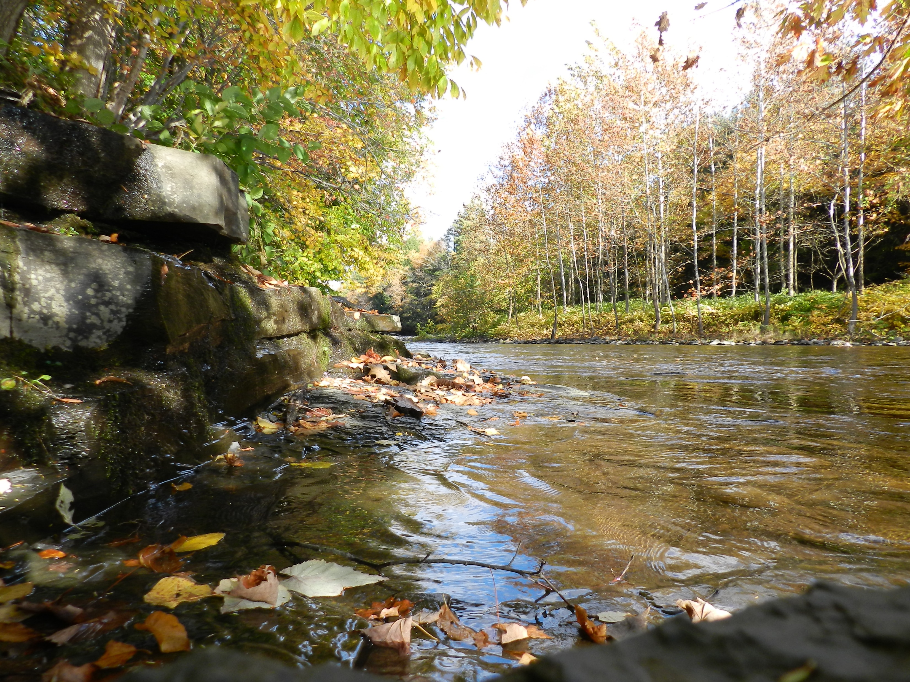
Trout Power, Inc.
“Catch the Power”
Tug Hill – Black River Chapter
Trout Unlimited

Slide 24

What is Trout Power?
Trout Power is 501c3 nonprofit organization (established in 2017) with the mission statement:
Enlisting the power of anglers to protect, restore and enhance native brook trout populations and their habitats across their native range, through citizen science, advocacy and stewardship

Slide 25
What does Trout Power do?
Trout Power uses volunteer anglers as citizen scientists to take part in a variety of different projects.
Trout Power has its own solo projects
Also work with other groups and organizations such as the DEC and TU.
We work with Universities on various projects

Slide 26
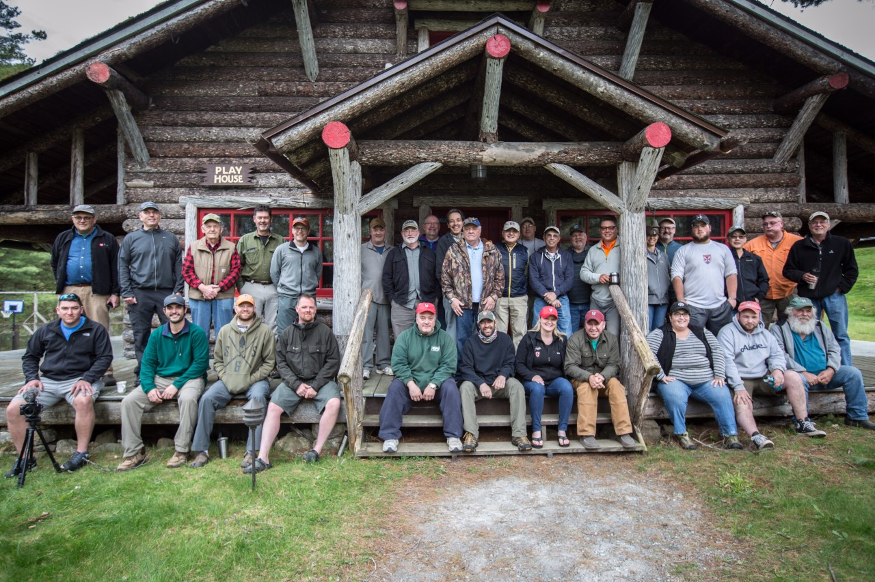
What is citizen science?
Citizen science is a form of scientific research that is conducted, in whole or in part, by amateur scientists.
Trout Power’s projects involve volunteers doing the field portion of the research, while professionals and academics perform the lab work and the analysis

Slide 27
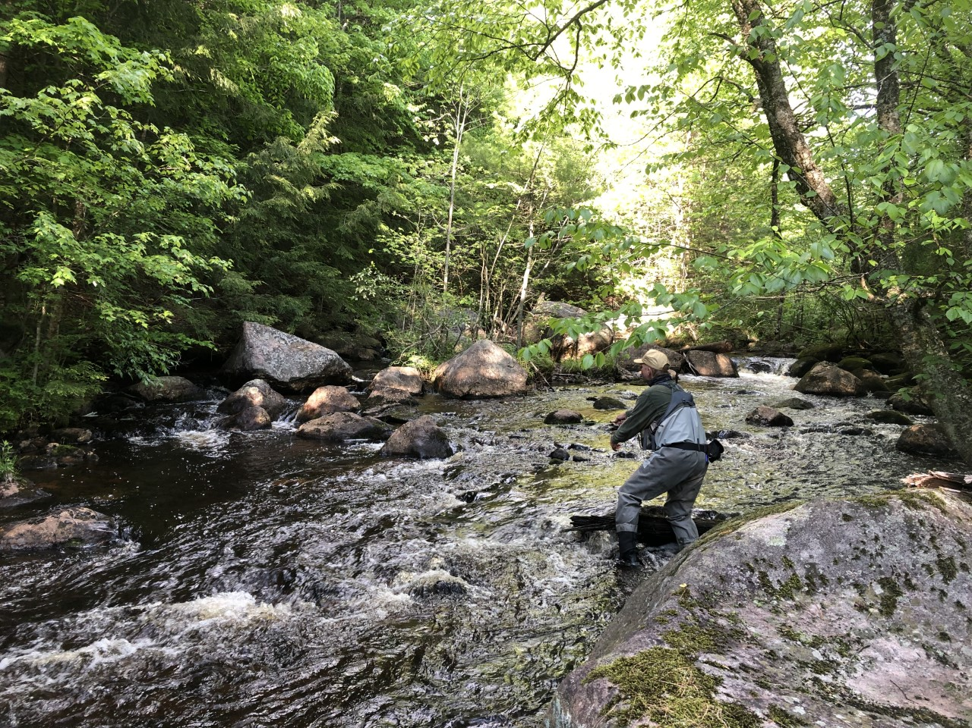
Advantages of Citizen Science
Economical - passionate volunteers!
More volunteers leads to larger amount of data over a wider expanse of area
Way to educate and connect the public to a cause
It’s fun!

Slide 28
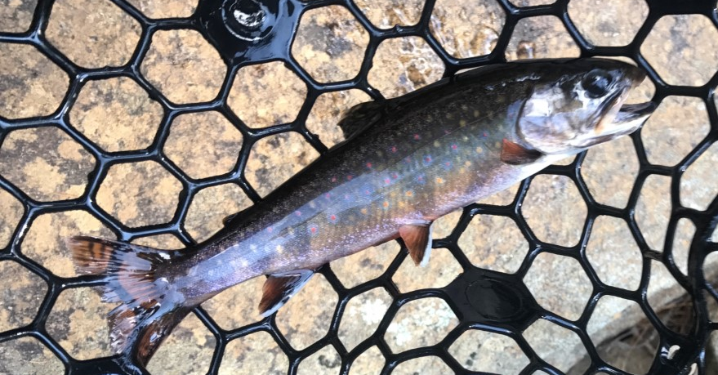
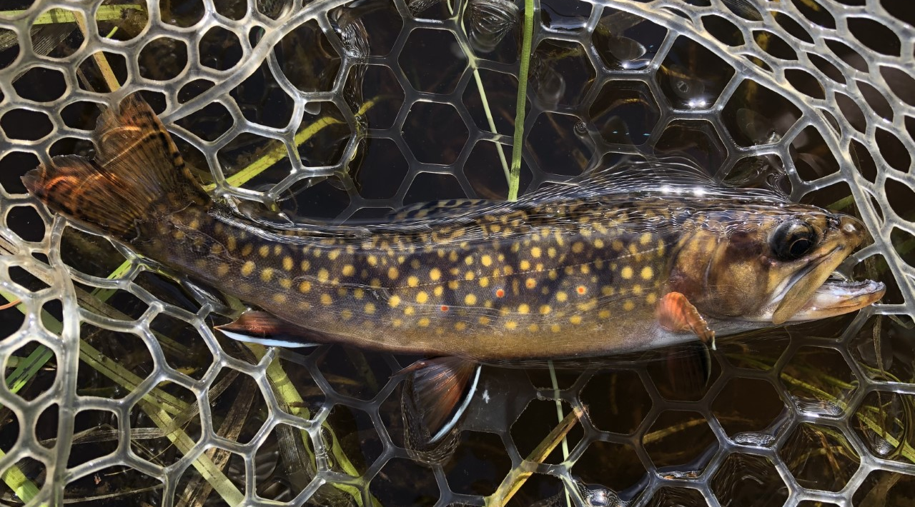
Genetic analysis- our bread and butter!
Since 2016, Trout Power has focused on searching for and identifying the genetic diversity of populations of brook trout in the Adirondack park.

Slide 29
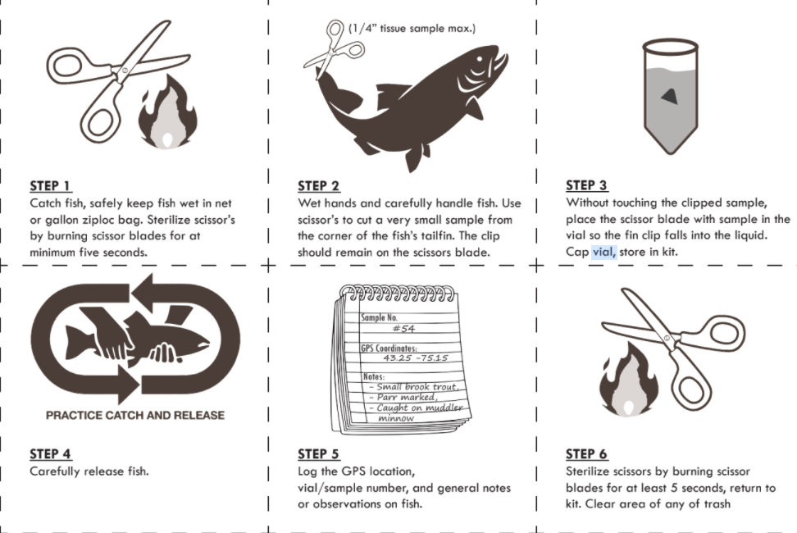
How we do this - Fin Clip protocol

Slide 30
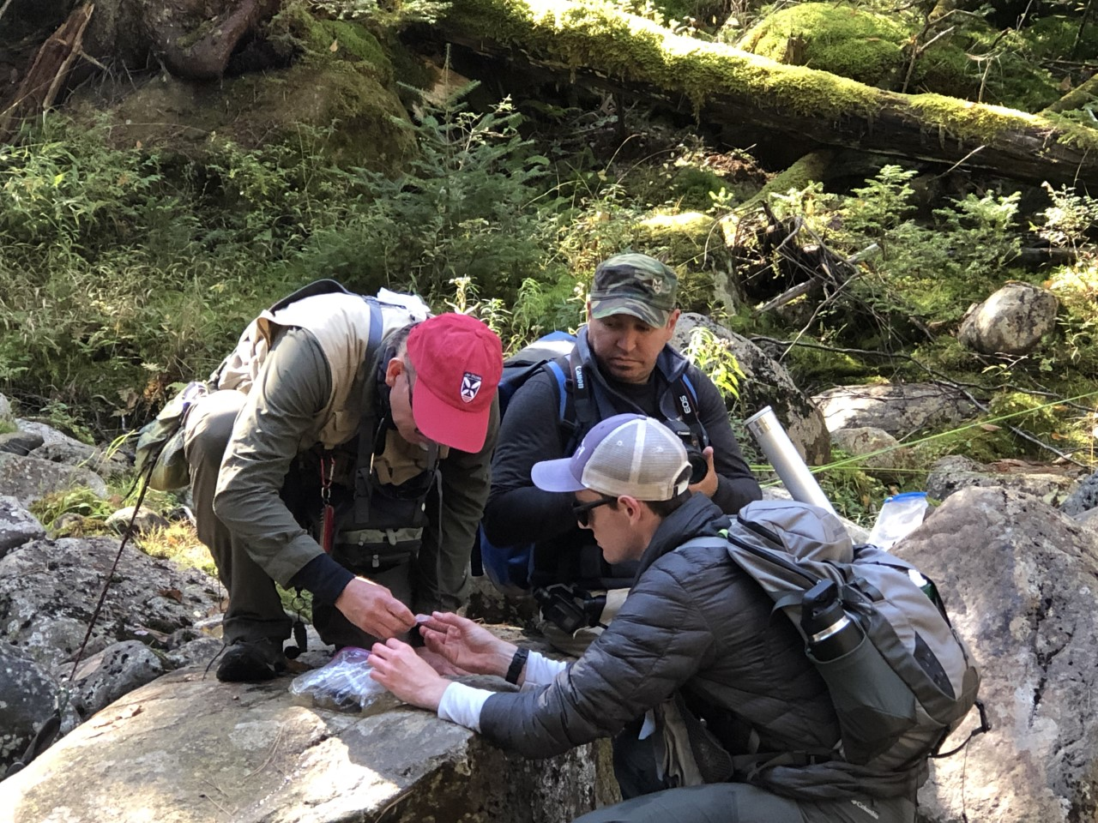
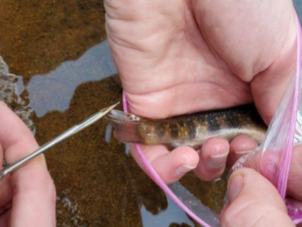
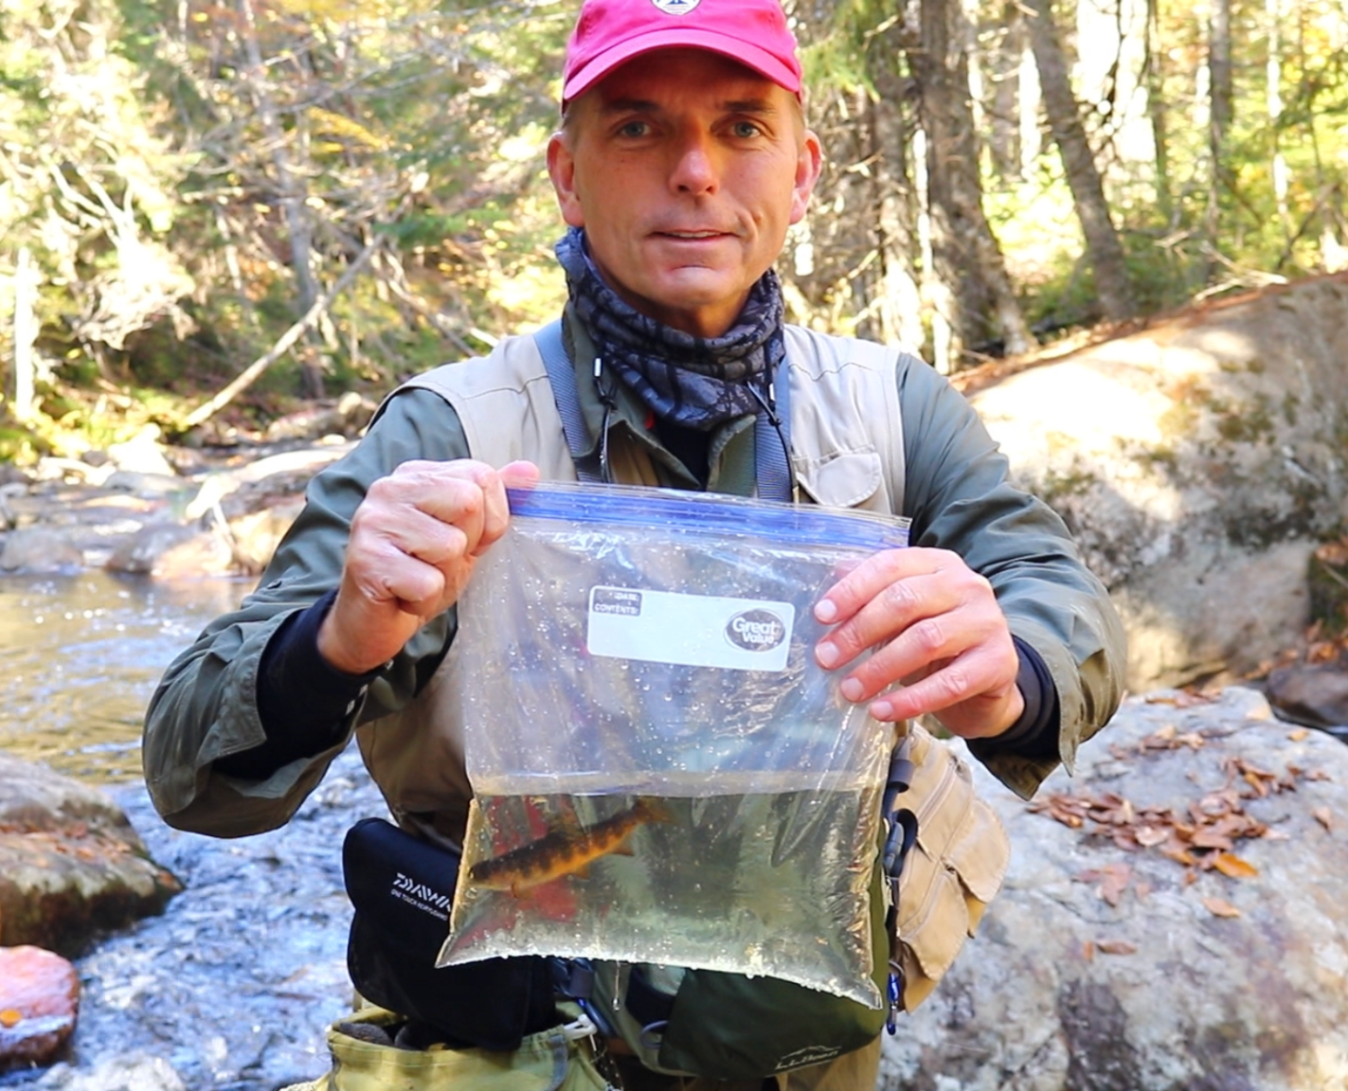
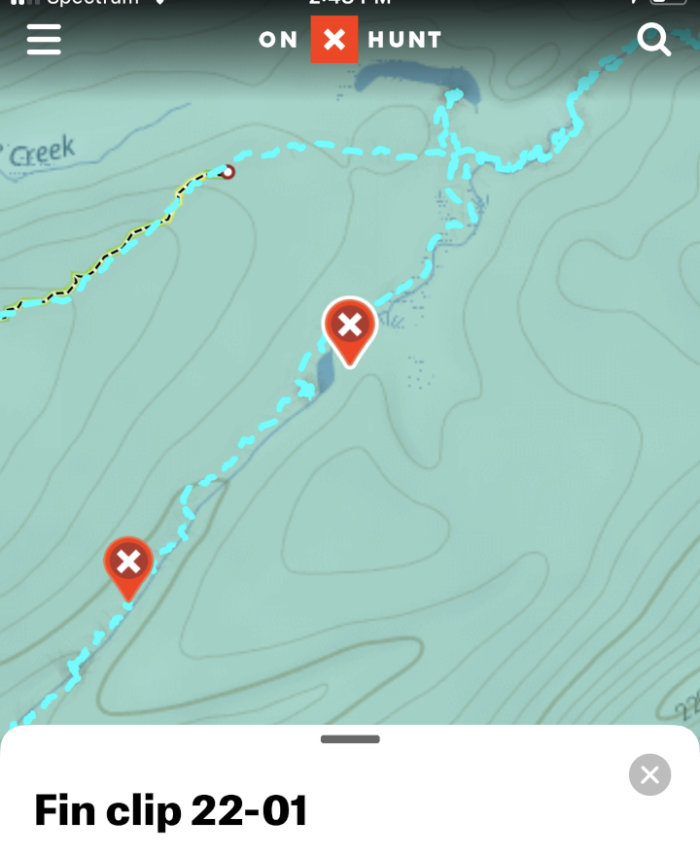
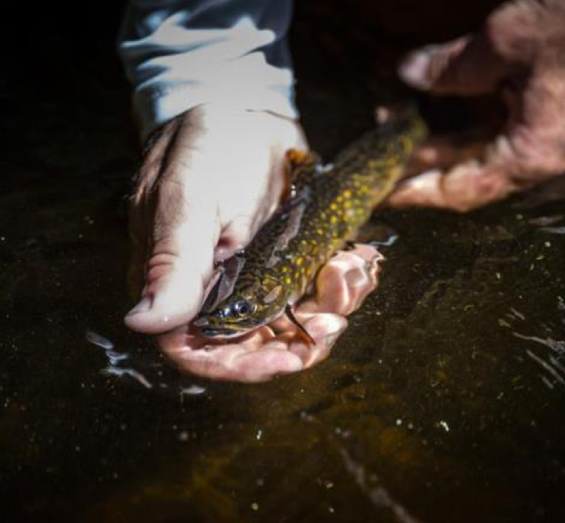
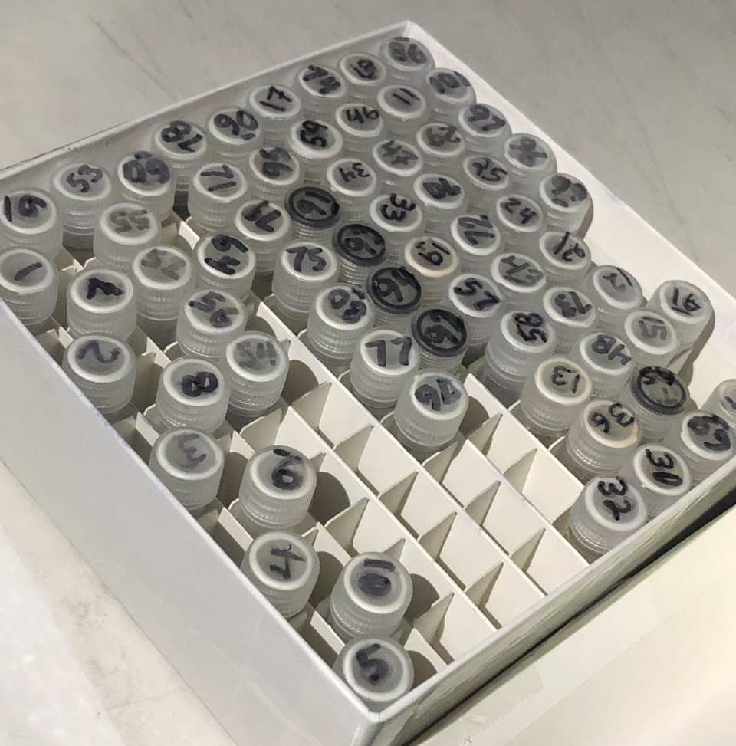

Slide 31
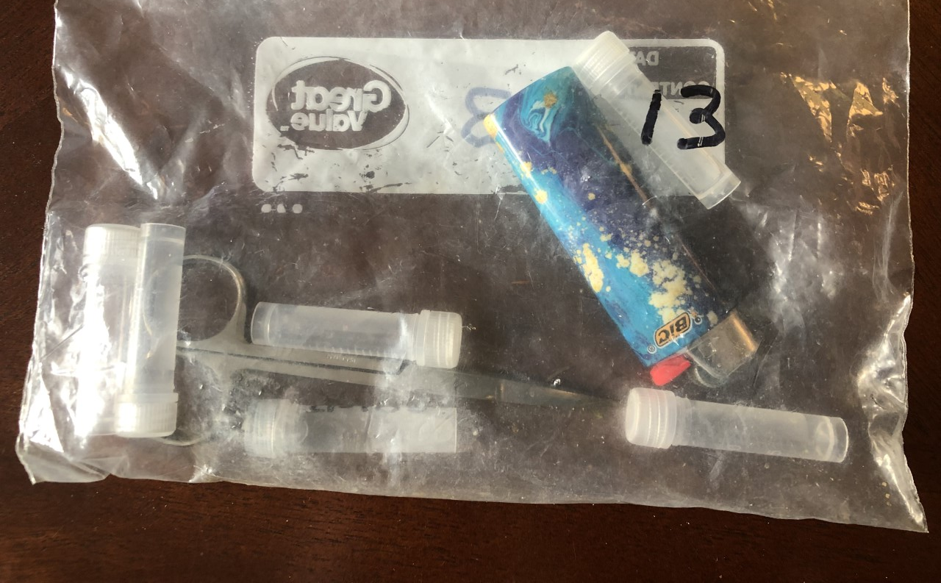
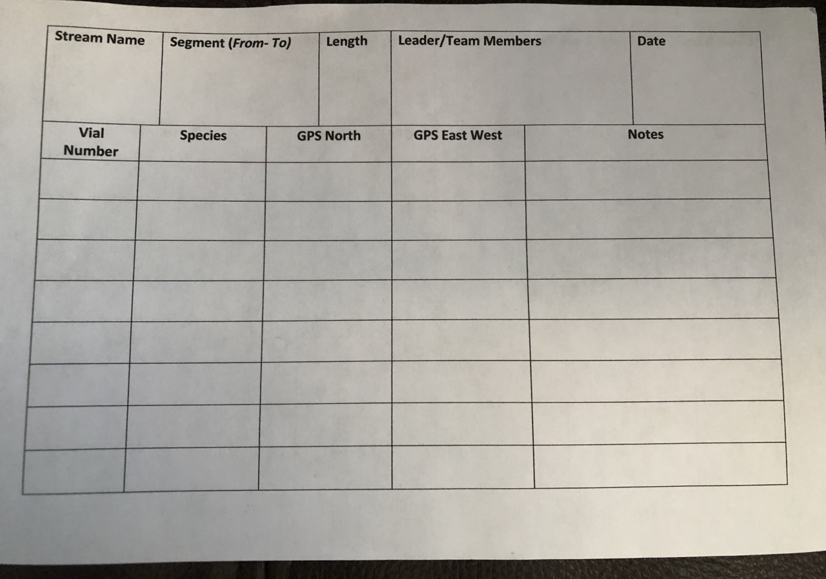
Fin clip kits
Volunteers who go into the field for Trout Power receive:
Fin clip kit
Scissors
Lighter (for sterilization)
Vials with ethanol for clips
Log sheet
Instructions on where to go and what direction to fish
**All volunteers sign waivers and are trained in safety procedures before going into the field

Slide 32
Type of Genetic Analysis Done 2016-2019
From 2016 - 2019, Trout Power used a genetic analysis technique called microsatellite analysis.
The following is a surface level synopsis of how microsat works and the genetic data it has provided us.

Slide 33
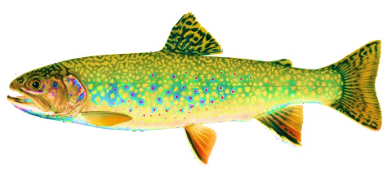
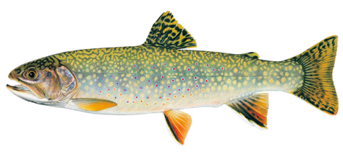
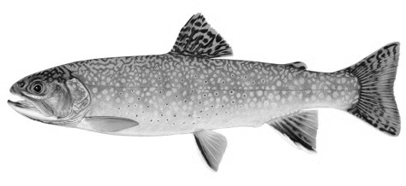
Microsatellite analysis
We can visualize this across many fish with bar plots that represent the percentage of ancestry derived from each population (where each vertical bar represents a fish)
Population 1
GCGCGCGCGCGCGCGC
GCGCGCGCGCGCGC
GCGCGCGCGCGCGCGC
GCGCGCGCGCGCGCGC
Pop 1 / Hatchery Hybrid
GCGCGCGCGCGCGCGC
GCGCGC
GCGCGCGCGCGCGCGC
GCGCGC
Hatchery Population
GCGCGC
GCGCGC
GCGCGC
GCGCGC
Pop 1
Hatchery
Hybrid
Notes:
Talk about three types of brook trout
Talk about their 3 options in regards to habitat degradation (MOVE, ADAPT or DIE)

Slide 34
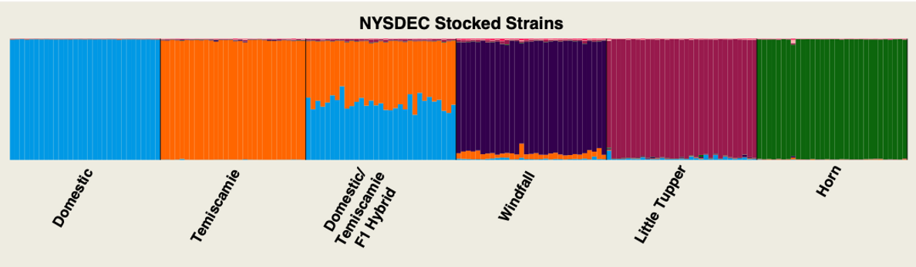

Example of using microsat and stocked strains
Trout Power Collected Samples

Slide 35
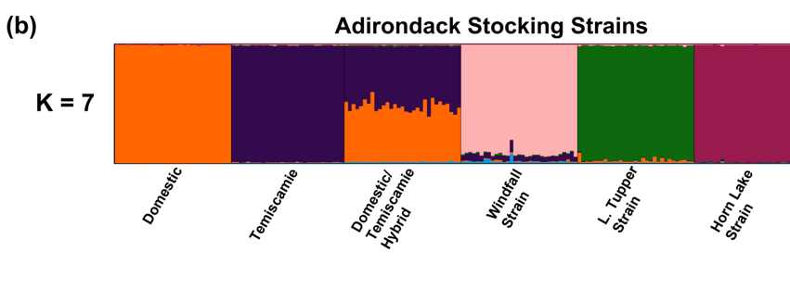
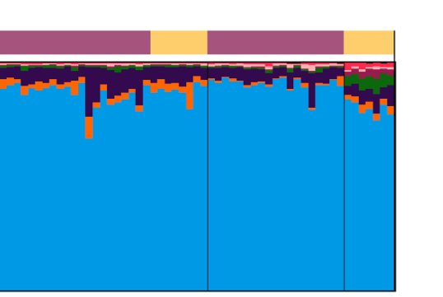
Trout Power Genetic studies performed- 2016
Adirondack Stocking Strains Samples collected in 2016
Blue coloration shows unique genetics that do not match with any stocked strains

Slide 36
Results from Trout Power - Tug Hill TU Collaboration

Slide 37
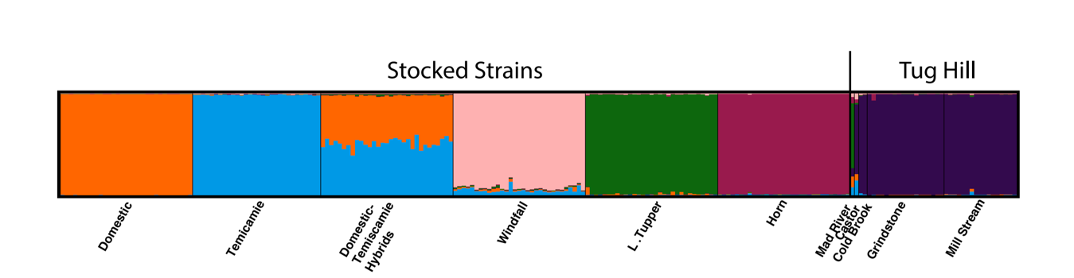
Trout Unlimited / Trout Power Genetic study
2019 Tug Hill
Adirondack Stocking Strains Samples collected in 2019

Slide 38
NewYork
Priority Waters

Slide 39
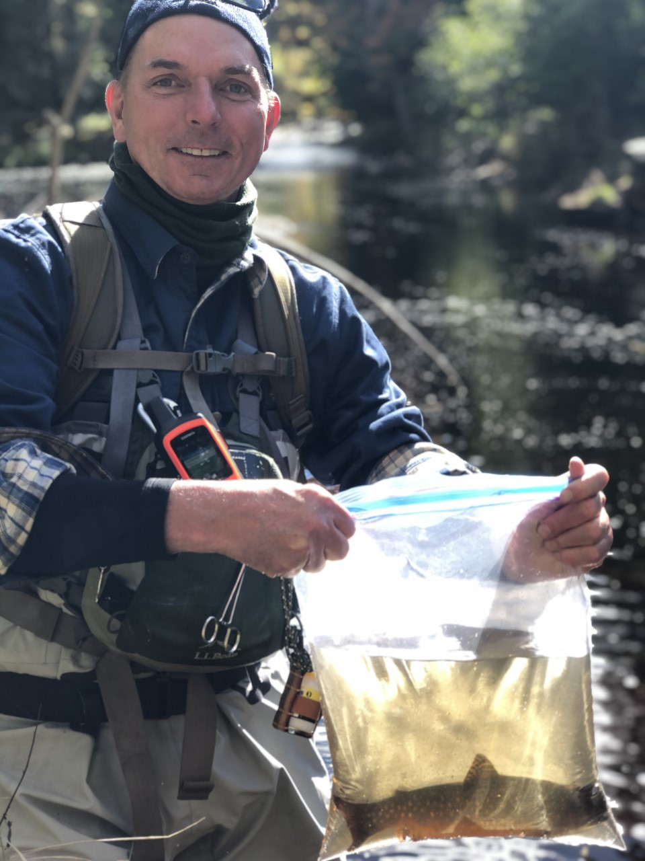



Where to find us:
Website: Troutpower.org
Become a member! Various levels of membership available
Instagram: troutpowerorg
Facebook: Trout Power

Slide 40
A stream without its fish is just a ditch.
troutpower.org
tu.org

